Slide 1
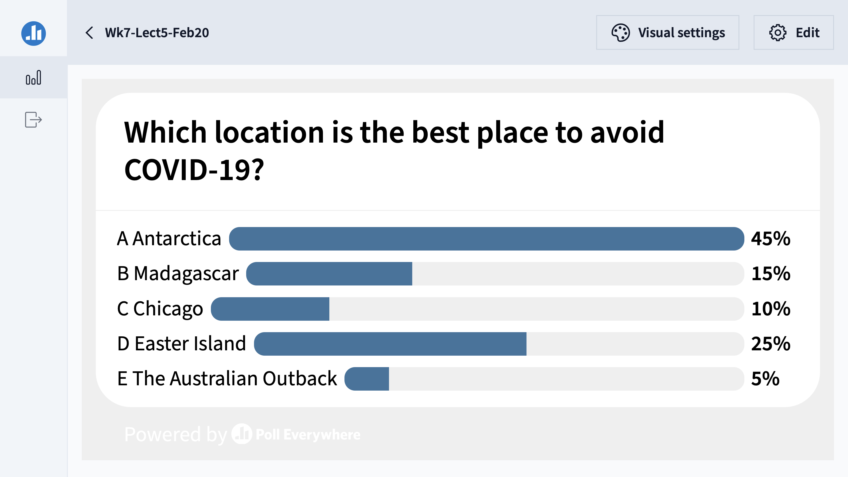

Slide 2
Fundamentals of Ecology
Week 7, Ecology Lecture 5
Cara Brook
February 20, 2025
Office hours: On ZOOM
Friday, Feb 21, 2025
4-5pm
I will email out a link!

Slide 3
Learning objectives from Lecture 4
You should be able to:
Understand and explain source-sink dynamics and an ecological trap
Describe an Allee effect
Understand trophic levels and know the direction of energy transfer, including what might happen to one level if there was a perturbation to a different level
Know the ecosystem-level rules of HSS
Understand the phase portrait in a Lotka-Volterra predator-prey model, including which direction to move forward in time
Recognize a trophic cascade.

Slide 4
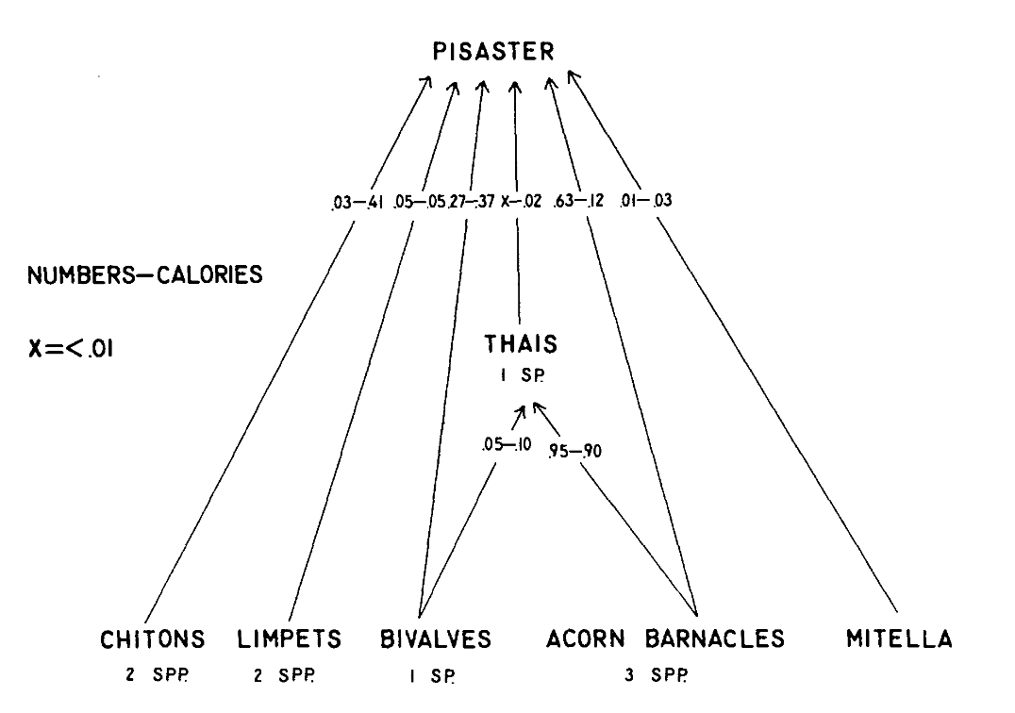
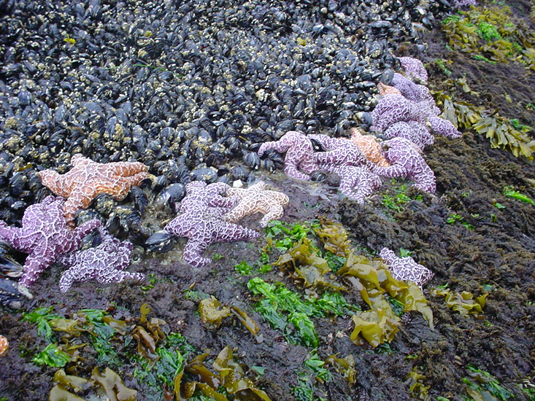
This work inspired empirical studies on trophic cascades:
Pisaster removal on Tatoosh Island
Paine 1966. The American Naturalist.
Notes:
In one of the most famous empirical experiments in ecology, Paine removed the dominant predator, Pisaster from the intertidal ecosystem in Tatoosh Island, WA, In the absence of a predator’s top-down control. the ecosystem lost diversity

Slide 5
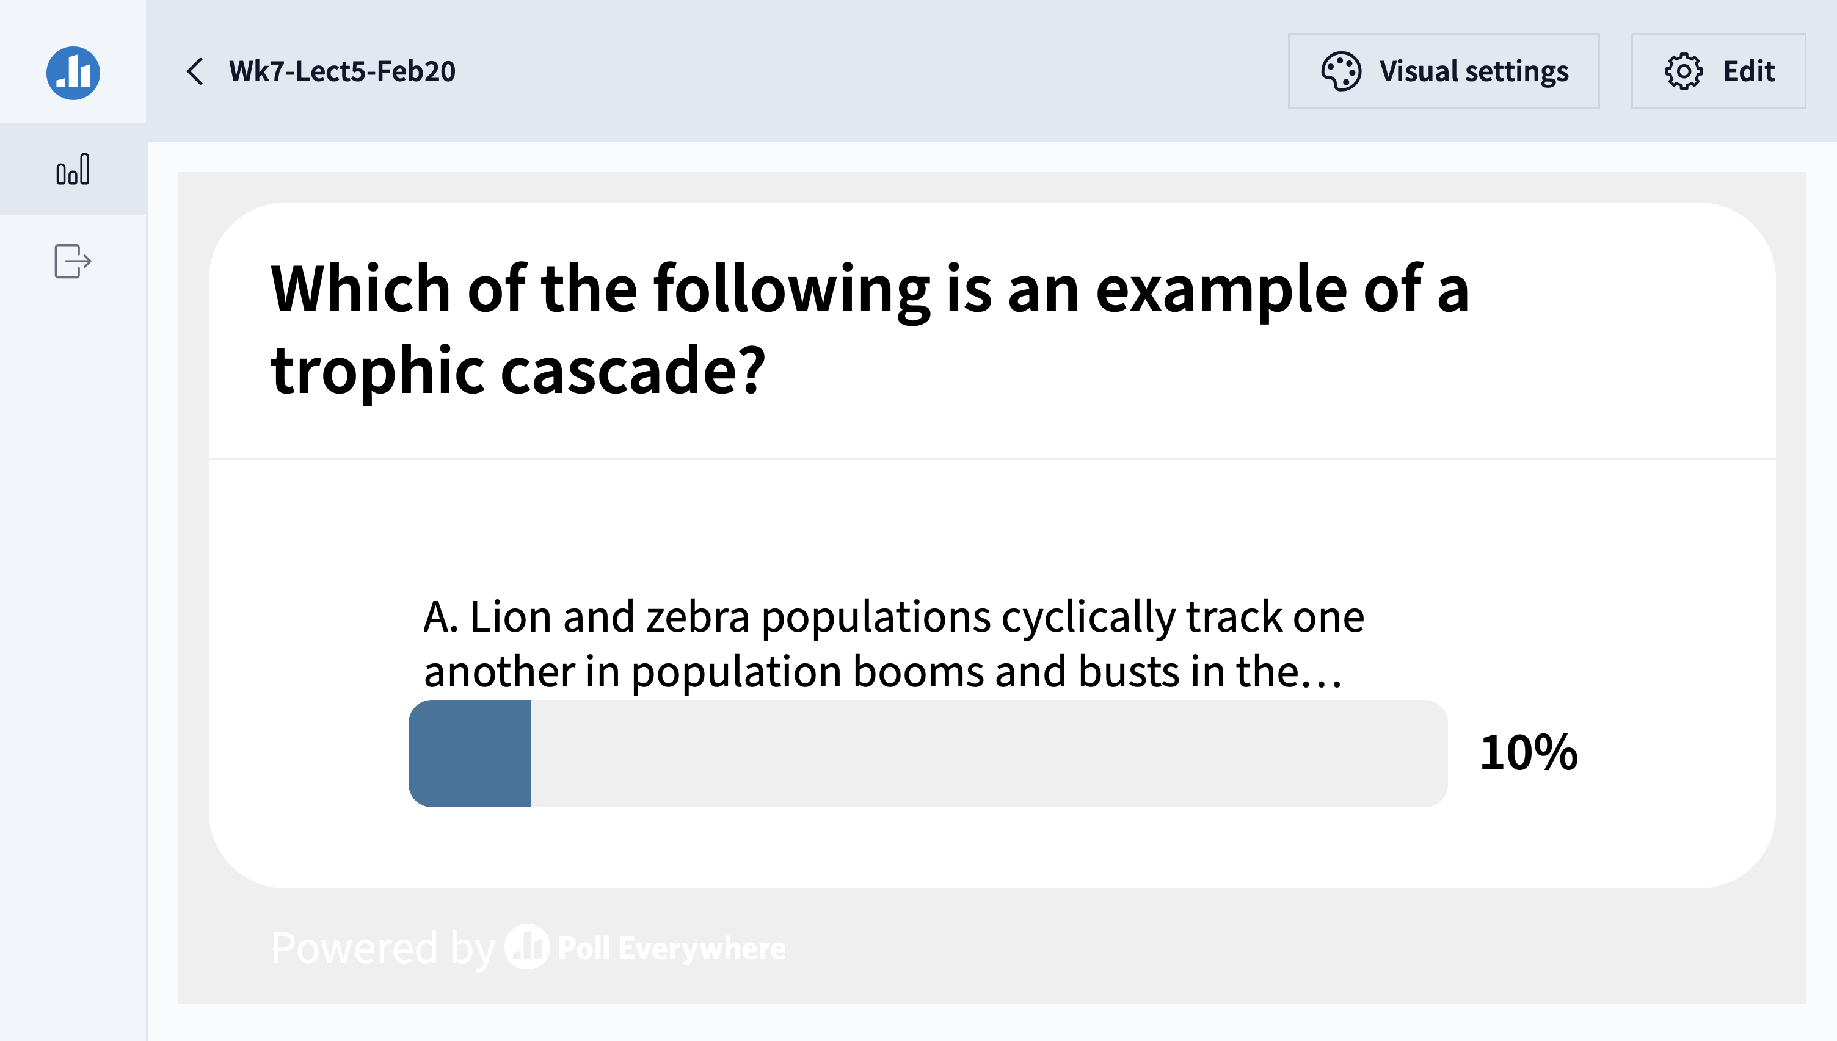

Slide 6
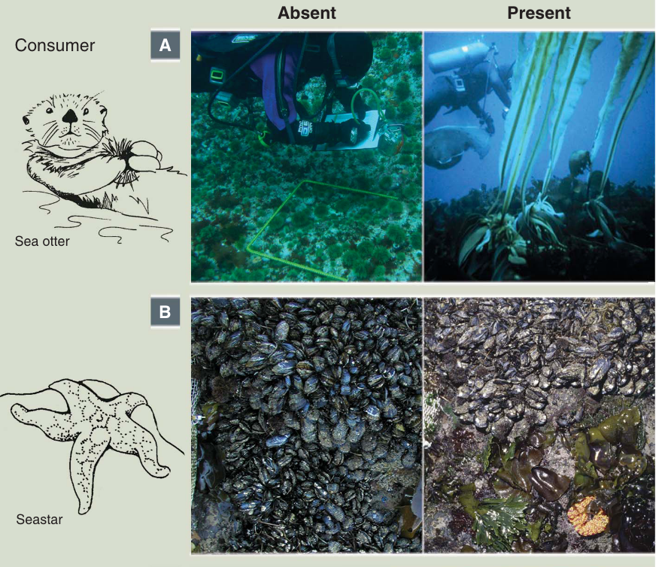
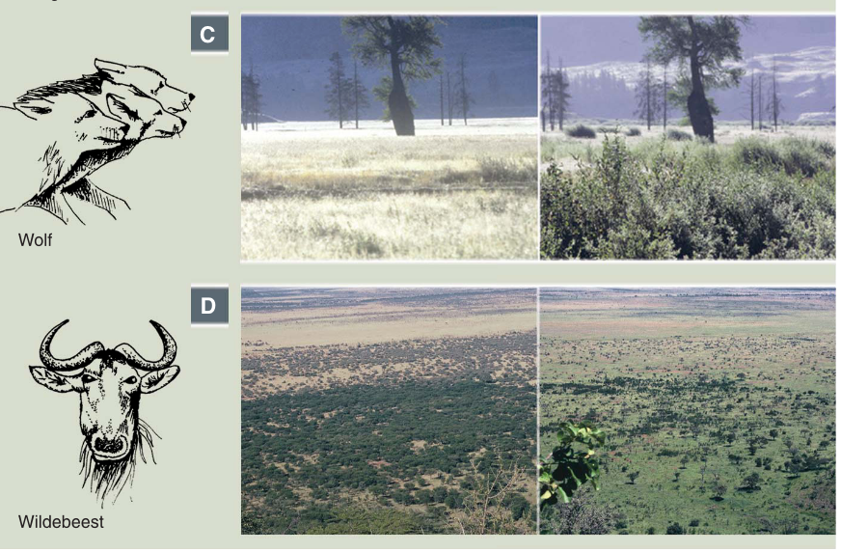
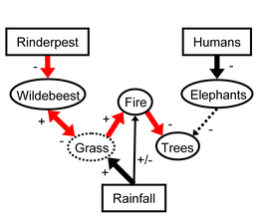
Other famous trophic cascades:
Estes et al. 2011. Science.
CA sea otters maintain kelp forest diversity by consuming herbivorous sea urchins. (Estes & Duggins 1995. Ecological Monographs)
Starfish maintain diversity in Pacific intertidal by consuming space-dominating mussels. (Paine 1966 The American Naturalist)
Yellowstone wolves promote willow recovery by consuming overbrowsing elk (Ripple & Beschta 2005. Forest Ecology & Management)
Rinderpest eradication releases wildebeest populations that control savanna, limit fire, and promote tree regrowth (Holdo et al. 2009. PLoS Biology)
Notes:
In one of the most famous empirical experiments in ecology, Paine removed the dominant predator, Pisaster from the intertidal ecosystem in Tatoosh Island, WA, In the absence of a predator’s top-down control, the ecosystem

Slide 7
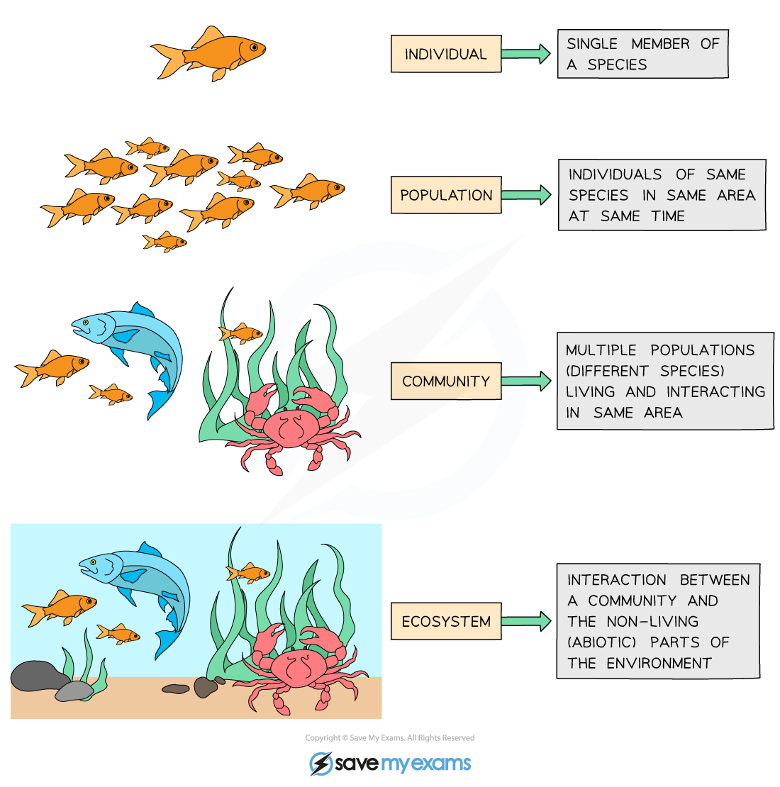
Community = interacting populations of different species
individual
population
fish
(x)
metapopulation
shark
(y)
community
How does fish abundance vary with changes in shark abundance?
ecosystem

Slide 8
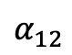
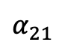
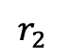
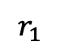
Community = interacting populations of different species
individual
population
$$α_{12}$$
$$r_{1}$$
metapopulation
Fish A
(x₁)
Fish B
(x₂)
$$r_{2}$$
community
$$α_{21}$$
How does the abundance of fish species A vary with changes in the abundance of fish species B?
ecosystem

Slide 9
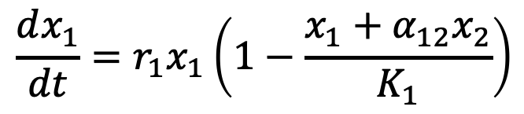
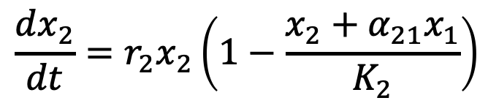
Lotka-Volterra equation can be modified for interspecies competition.
$$\frac{dx_{1}}{dt}={r_{1}x}_{1}\left(1−\frac{x_{1}+α_{12}x_{2}}{K_{1}}\right)$$
$$\frac{dx_{2}}{dt}={r_{2}x}_{2}\left(1−\frac{x_{2}+α_{21}x_{1}}{K_{2}}\right)$$

Slide 10
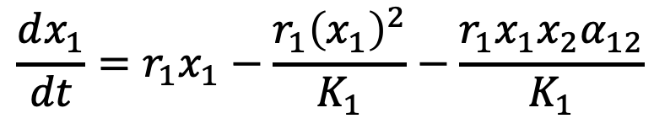
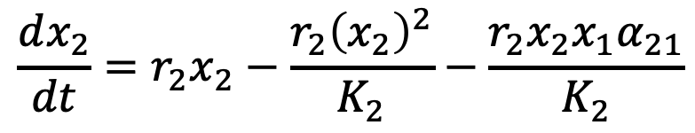
Lotka-Volterra equation can be modified for interspecies competition.
$$\frac{dx_{1}}{dt}={r_{1}x}_{1}−\frac{r_{1}{\left(x_{1}\right)}^{2}}{K_{1}}−\frac{r_{1}x_{1}x_{2}α_{12}}{K_{1}}$$
$$\frac{dx_{2}}{dt}={r_{2}x}_{2}−\frac{r_{2}{\left(x_{2}\right)}^{2}}{K_{2}}−\frac{r_{2}x_{2}x_{1}α_{21}}{K_{2}}$$

Slide 11
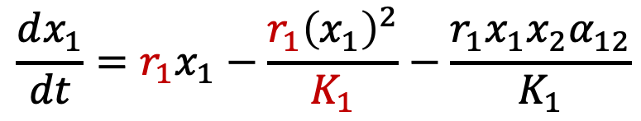
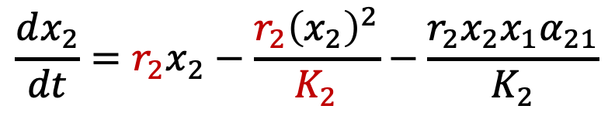
Lotka-Volterra equation can be modified for interspecies competition.
intraspecies competition of species 1 (akin to logistic growth)
Each species is self-regulated by logistic growth and its own carrying capacity (K) and growth rate (r).
But also regulated by the density of its competitor (e.g. for a specific resource).
$$\frac{dx_{1}}{dt}={r_{1}x}_{1}−\frac{r_{1}{\left(x_{1}\right)}^{2}}{K_{1}}−\frac{r_{1}x_{1}x_{2}α_{12}}{K_{1}}$$
$$\frac{dx_{2}}{dt}={r_{2}x}_{2}−\frac{r_{2}{\left(x_{2}\right)}^{2}}{K_{2}}−\frac{r_{2}x_{2}x_{1}α_{21}}{K_{2}}$$
intraspecies competition of species 2

Slide 12
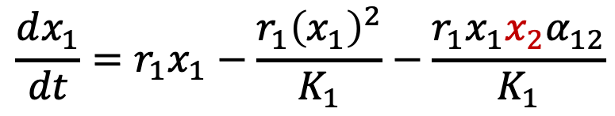
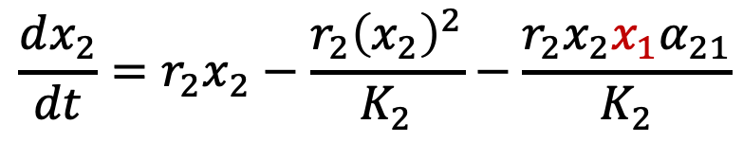
Lotka-Volterra equation can be modified for interspecies competition.
intraspecies competition of species 1 (akin to logistic growth)
interspecies competition with species 2
Each species is self- regulated by logistic growth and its own carrying capacity (K) and growth rate (r).
Each species is also regulated by the density of its competitor (e.g. for a specific resource).
$$\frac{dx_{1}}{dt}={r_{1}x}_{1}−\frac{r_{1}{\left(x_{1}\right)}^{2}}{K_{1}}−\frac{r_{1}x_{1}x_{2}α_{12}}{K_{1}}$$
$$\frac{dx_{2}}{dt}={r_{2}x}_{2}−\frac{r_{2}{\left(x_{2}\right)}^{2}}{K_{2}}−\frac{r_{2}x_{2}x_{1}α_{21}}{K_{2}}$$
intraspecies competition of species 2
interspecies competition with species 1

Slide 13
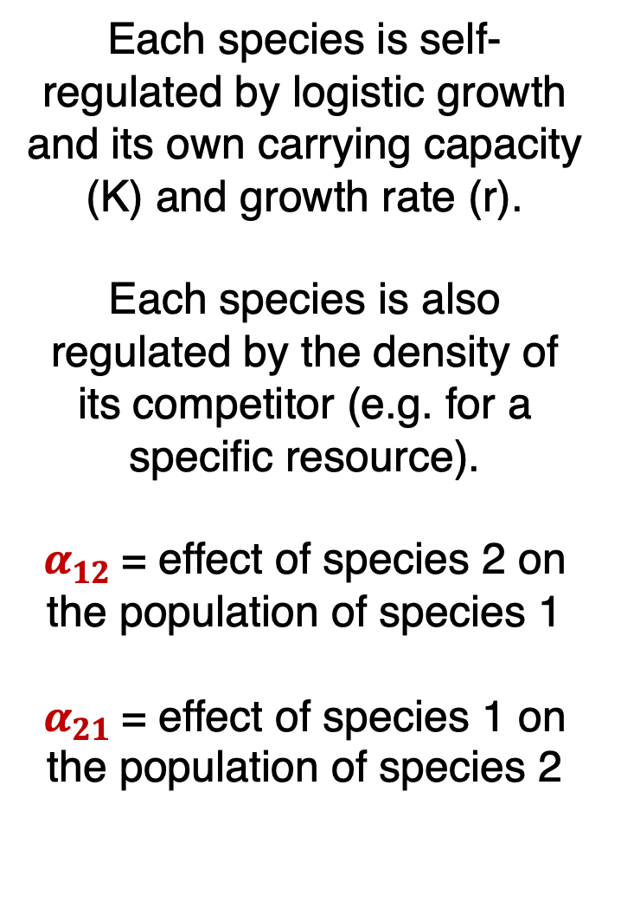
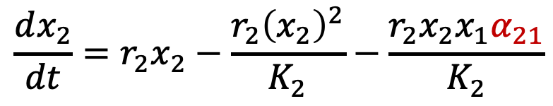

Lotka-Volterra equation can be modified for interspecies competition.
intraspecies competition of species 1 (akin to logistic growth)
interspecies competition with species 2
Each species is self- regulated by logistic growth and its own carrying capacity (K) and growth rate (r).
Each species is also regulated by the density of its competitor (e.g. for a specific resource).
$α_{12}$= effect of species 2 on the population of species 1
$α_{21}$= effect of species 1 on the population of species 2
$$\frac{dx_{1}}{dt}={r_{1}x}_{1}−\frac{r_{1}{\left(x_{1}\right)}^{2}}{K_{1}}−\frac{r_{1}x_{1}x_{2}α_{12}}{K_{1}}$$
$$\frac{dx_{2}}{dt}={r_{2}x}_{2}−\frac{r_{2}{\left(x_{2}\right)}^{2}}{K_{2}}−\frac{r_{2}x_{2}x_{1}α_{21}}{K_{2}}$$
intraspecies competition of species 2
interspecies competition with species 1

Slide 14
The 2-species Lotka-Volterra competition model has four equilibria.
Remember: equilibrium occurs when neither population is changing!

Slide 15
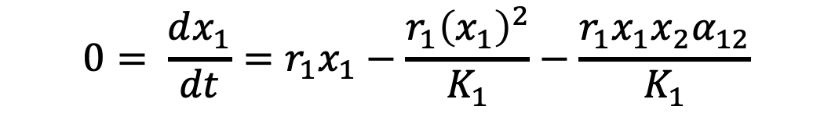
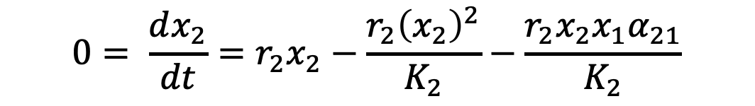
The 2-species Lotka-Volterra competition model has four equilibria.
Remember: equilibrium occurs when neither population is changing!
$$0= \frac{dx_{1}}{dt}={r_{1}x}_{1}−\frac{r_{1}{\left(x_{1}\right)}^{2}}{K_{1}}−\frac{r_{1}x_{1}x_{2}α_{12}}{K_{1}}$$
$$0= \frac{dx_{2}}{dt}={r_{2}x}_{2}−\frac{r_{2}{\left(x_{2}\right)}^{2}}{K_{2}}−\frac{r_{2}x_{2}x_{1}α_{21}}{K_{2}}$$

Slide 16
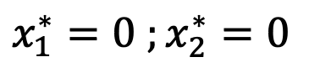
The 2-species Lotka-Volterra competition model has four equilibria.
Remember: equilibrium occurs when neither population is changing!
$$0= \frac{dx_{1}}{dt}={r_{1}x}_{1}−\frac{r_{1}{\left(x_{1}\right)}^{2}}{K_{1}}−\frac{r_{1}x_{1}x_{2}α_{12}}{K_{1}}$$
$$0= \frac{dx_{2}}{dt}={r_{2}x}_{2}−\frac{r_{2}{\left(x_{2}\right)}^{2}}{K_{2}}−\frac{r_{2}x_{2}x_{1}α_{21}}{K_{2}}$$
Four equilibria at:
$$x_{1}^{∗}=0 ;x_{2}^{∗}=0$$
Trivial.

Slide 17
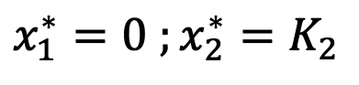
The 2-species Lotka-Volterra competition model has four equilibria.
Remember: equilibrium occurs when neither population is changing!
$$0= \frac{dx_{1}}{dt}={r_{1}x}_{1}−\frac{r_{1}{\left(x_{1}\right)}^{2}}{K_{1}}−\frac{r_{1}x_{1}x_{2}α_{12}}{K_{1}}$$
$$0= \frac{dx_{2}}{dt}={r_{2}x}_{2}−\frac{r_{2}{\left(x_{2}\right)}^{2}}{K_{2}}−\frac{r_{2}x_{2}x_{1}α_{21}}{K_{2}}$$
Four equilibria at:
$$x_{1}^{∗}=0 ;x_{2}^{∗}=0$$
$$x_{1}^{∗}=0 ;x_{2}^{∗}=K_{2}$$
Species 1 extinct. Species 2 at carrying capacity.

Slide 18
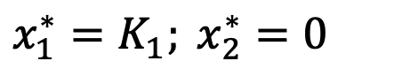
The 2-species Lotka-Volterra competition model has four equilibria.
Remember: equilibrium occurs when neither population is changing!
$$0= \frac{dx_{1}}{dt}={r_{1}x}_{1}−\frac{r_{1}{\left(x_{1}\right)}^{2}}{K_{1}}−\frac{r_{1}x_{1}x_{2}α_{12}}{K_{1}}$$
$$0= \frac{dx_{2}}{dt}={r_{2}x}_{2}−\frac{r_{2}{\left(x_{2}\right)}^{2}}{K_{2}}−\frac{r_{2}x_{2}x_{1}α_{21}}{K_{2}}$$
Four equilibria at:
$$x_{1}^{∗}=0 ;x_{2}^{∗}=0$$
$$x_{1}^{∗}=0 ;x_{2}^{∗}=K_{2}$$
$$x_{1}^{∗}=K_{1}; x_{2}^{∗}=0$$
Species 2 extinct. Species 1 at carrying capacity.

Slide 19
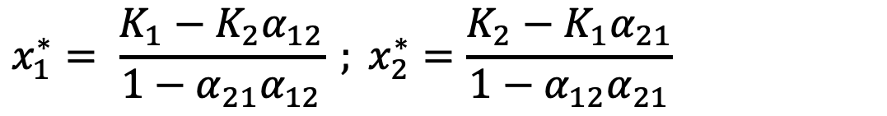
The 2-species Lotka-Volterra competition model has four equilibria.
Remember: equilibrium occurs when neither population is changing!
$$0= \frac{dx_{1}}{dt}={r_{1}x}_{1}−\frac{r_{1}{\left(x_{1}\right)}^{2}}{K_{1}}−\frac{r_{1}x_{1}x_{2}α_{12}}{K_{1}}$$
$$0= \frac{dx_{2}}{dt}={r_{2}x}_{2}−\frac{r_{2}{\left(x_{2}\right)}^{2}}{K_{2}}−\frac{r_{2}x_{2}x_{1}α_{21}}{K_{2}}$$
Four equilibria at:
$$x_{1}^{∗}=0 ;x_{2}^{∗}=0$$
$$x_{1}^{∗}=0 ;x_{2}^{∗}=K_{2}$$
$$x_{1}^{∗}=K_{1}; x_{2}^{∗}=0$$
$$x_{1}^{∗}= \frac{K_{1}−K_{2}α_{12}}{1−α_{21}α_{12}} ; x_{2}^{∗}=\frac{K_{2}−K_{1}α_{21}}{1−α_{12}α_{21}}$$
Coexistence.

Slide 20
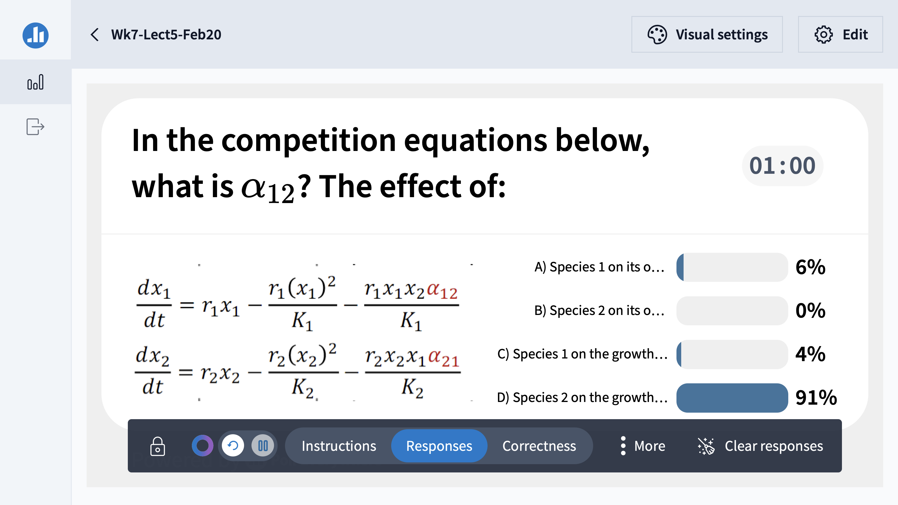

Slide 21
Nullclines (or isoclines) of the Lotka-Volterra competition model
These are the lines that correspond to the conditions when the rate of change for one species is not changing!
Notes:
For 2024, explain these phase planes as trajectories of the system. Each nullcline represents the conditions under which the RATE of change for each species is not changing. The two will eventually converge to the equilibria but at different rates. That rate will cease changing for each species when you reach the nullcline.
Also would be helpful to show the time series of the two species and how that translates to the nullcline.

Slide 22
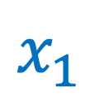
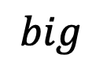
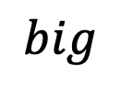
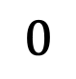
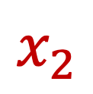
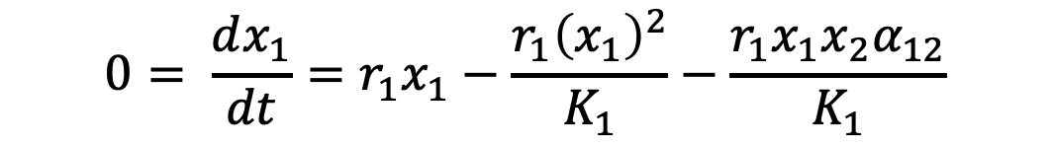
Nullclines (or isoclines) of the Lotka-Volterra competition model
These are the lines that correspond to conditions when the rate of change for one species is 0.
Nullclines for species 1 occur at all conditions for which $\frac{dx_{1}}{dt}=0$
$$0= \frac{dx_{1}}{dt}={r_{1}x}_{1}−\frac{r_{1}{\left(x_{1}\right)}^{2}}{K_{1}}−\frac{r_{1}x_{1}x_{2}α_{12}}{K_{1}}$$
$$big$$
$$x_{2}$$
$$0$$
$$x_{1}$$
$$big$$

Slide 23


Nullclines (or isoclines) of the Lotka-Volterra competition model
These are the lines that correspond to conditions when the rate of change for one species is 0.
Nullclines for species 1 occur at all conditions for which $\frac{dx_{1}}{dt}=0$
$$0= \frac{dx_{1}}{dt}={r_{1}x}_{1}−\frac{r_{1}{\left(x_{1}\right)}^{2}}{K_{1}}−\frac{r_{1}x_{1}x_{2}α_{12}}{K_{1}}$$
$$big$$
$$0={r_{1}x}_{1}−\frac{r_{1}{\left(x_{1}\right)}^{2}}{K_{1}}−\frac{r_{1}x_{1}x_{2}α_{12}}{K_{1}}$$
$$0={r_{1}x}_{1}\left(1−\frac{x_{1}}{K_{1}}−\frac{x_{2}α_{12}}{K_{1}}\right)$$
$$x_{2}$$
$$0$$
$$x_{1}$$
$$big$$

Slide 24
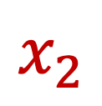
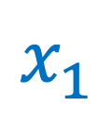

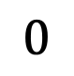
Nullclines (or isoclines) of the Lotka-Volterra competition model
These are the lines that correspond to conditions when the rate of change for one species is 0.
Nullclines for species 1 occur at all conditions for which $\frac{dx_{1}}{dt}=0$
$$0= \frac{dx_{1}}{dt}={r_{1}x}_{1}−\frac{r_{1}{\left(x_{1}\right)}^{2}}{K_{1}}−\frac{r_{1}x_{1}x_{2}α_{12}}{K_{1}}$$
$$0={r_{1}x}_{1}−\frac{r_{1}{\left(x_{1}\right)}^{2}}{K_{1}}−\frac{r_{1}x_{1}x_{2}α_{12}}{K_{1}}$$
$$0={r_{1}x}_{1}\left(1−\frac{x_{1}}{K_{1}}−\frac{x_{2}α_{12}}{K_{1}}\right)$$
$$x_{2}$$
first nullcline at $x_{1}=0$
$$0$$
$$x_{1}$$

Slide 25
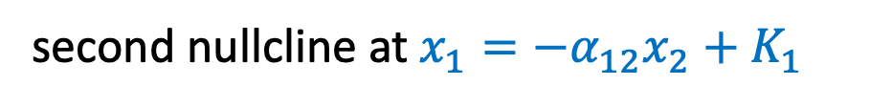
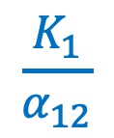
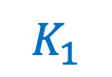
Nullclines (or isoclines) of the Lotka-Volterra competition model
These are the lines that correspond to conditions when the rate of change for one species is 0.
Nullclines for species 1 occur at all conditions for which $\frac{dx_{1}}{dt}=0$
$$0= \frac{dx_{1}}{dt}={r_{1}x}_{1}−\frac{r_{1}{\left(x_{1}\right)}^{2}}{K_{1}}−\frac{r_{1}x_{1}x_{2}α_{12}}{K_{1}}$$
$$\frac{K_{1}}{α_{12}}$$
$$0={r_{1}x}_{1}−\frac{r_{1}{\left(x_{1}\right)}^{2}}{K_{1}}−\frac{r_{1}x_{1}x_{2}α_{12}}{K_{1}}$$
$$0={r_{1}x}_{1}\left(1−\frac{x_{1}}{K_{1}}−\frac{x_{2}α_{12}}{K_{1}}\right)$$
$$x_{2}$$
first nullcline at $x_{1}=0$
second nullcline at $x_{1}=−α_{12}x_{2}+K_{1}$
$$0$$
$$x_{1}$$
$$K_{1}$$

Slide 26
Nullclines (or isoclines) of the Lotka-Volterra competition model
Following a perturbation, the population should return to equilibrium!
$$\frac{K_{1}}{α_{12}}$$
$$x_{2}$$
$$0$$
$$x_{1}$$
$$K_{1}$$

Slide 27
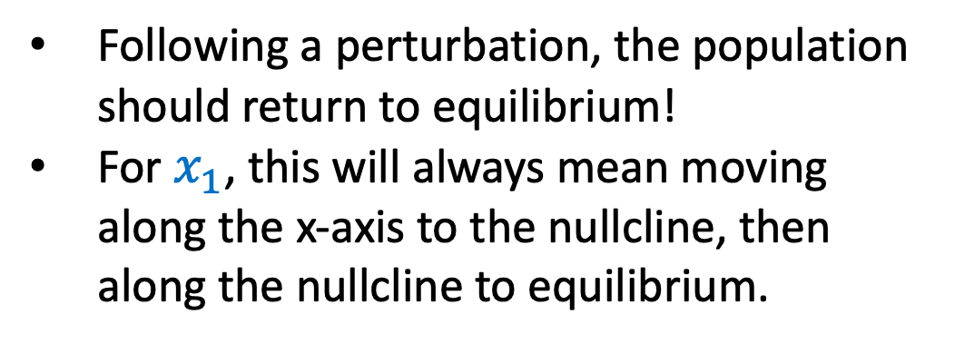
Nullclines (or isoclines) of the Lotka-Volterra competition model
Following a perturbation, the population should return to equilibrium!
For $x_{1}$, this will always mean moving along the x-axis to the nullcline, then along the nullcline to equilibrium.
$$\frac{K_{1}}{α_{12}}$$
$$x_{2}$$
$$0$$
$$x_{1}$$
$$K_{1}$$

Slide 28
Nullclines (or isoclines) of the Lotka-Volterra competition model
Following a perturbation, the population should return to equilibrium!
For $x_{1}$, this will always mean moving along the x-axis to the nullcline, then along the nullcline to equilibrium.
$$\frac{K_{1}}{α_{12}}$$
$$x_{2}$$
$$0$$
$$x_{1}$$
$$K_{1}$$

Slide 29
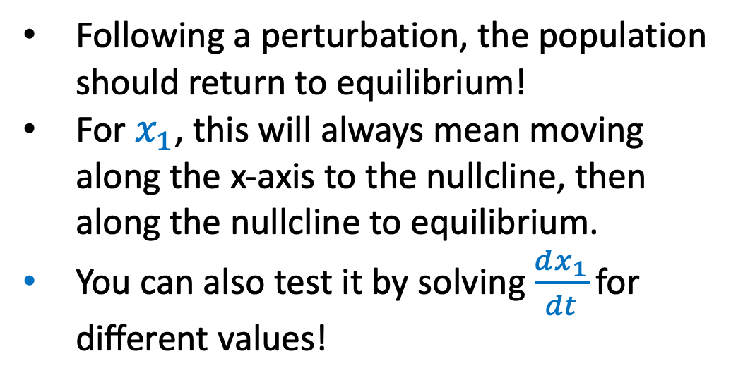

Nullclines (or isoclines) of the Lotka-Volterra competition model
$$\frac{dx_{1}}{dt}={r_{1}x}_{1}\left(1−\frac{x_{1}}{K_{1}}−\frac{x_{2}α_{12}}{K_{1}}\right)$$
Following a perturbation, the population should return to equilibrium!
For $x_{1}$, this will always mean moving along the x-axis to the nullcline, then along the nullcline to equilibrium.
You can also test it by solving $\frac{dx_{1}}{dt}\text{for} \text{different} \text{values}\text{!}$
$$\frac{K_{1}}{α_{12}}$$
$$x_{2}$$
$$0$$
$$x_{1}$$
$$K_{1}$$

Slide 30
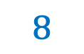
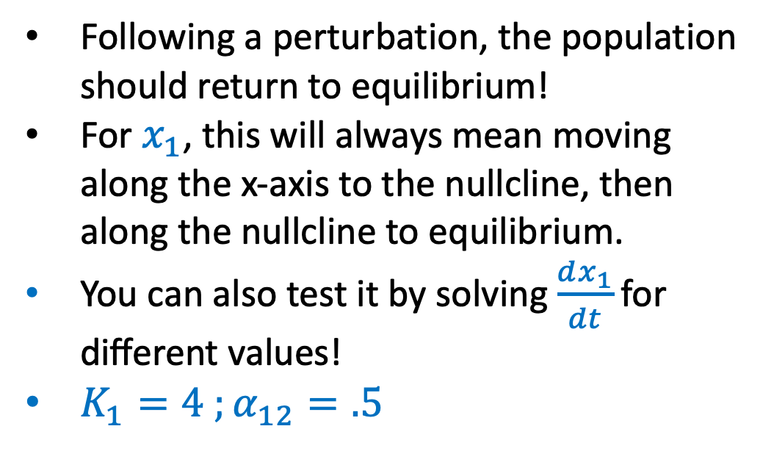
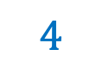

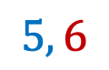
Nullclines (or isoclines) of the Lotka-Volterra competition model
$$\frac{dx_{1}}{dt}={r_{1}x}_{1}\left(1−\frac{x_{1}}{K_{1}}−\frac{x_{2}α_{12}}{K_{1}}\right)$$
Following a perturbation, the population should return to equilibrium!
For $x_{1}$, this will always mean moving along the x-axis to the nullcline, then along the nullcline to equilibrium.
You can also test it by solving $\frac{dx_{1}}{dt}\text{for} \text{different} \text{values}\text{!}$
$K_{1}=4 ;α_{12}=.5$
$$8$$
$$5, 6$$
$$x_{2}$$
$$0$$
$$x_{1}$$
$$4$$

Slide 31

Nullclines (or isoclines) of the Lotka-Volterra competition model
$$\frac{dx_{1}}{dt}={r_{1}x}_{1}\left(1−\frac{x_{1}}{K_{1}}−\frac{x_{2}α_{12}}{K_{1}}\right)$$
Following a perturbation, the population should return to equilibrium!
For $x_{1}$, this will always mean moving along the x-axis to the nullcline, then along the nullcline to equilibrium.
You can also test it by solving $\frac{dx_{1}}{dt}\text{for} \text{different} \text{values}\text{!}$
$K_{1}=4 ;α_{12}=.5$
$$\frac{dx_{1}}{dt}=r_{1}∗5\left(1−\frac{5}{4}−\frac{6∗.5}{4}\right)$$
$$8$$
$$5, 6$$
$$x_{2}$$
$$0$$
$$x_{1}$$
$$4$$

Slide 32

Nullclines (or isoclines) of the Lotka-Volterra competition model
$$\frac{dx_{1}}{dt}={r_{1}x}_{1}\left(1−\frac{x_{1}}{K_{1}}−\frac{x_{2}α_{12}}{K_{1}}\right)$$
Following a perturbation, the population should return to equilibrium!
For $x_{1}$, this will always mean moving along the x-axis to the nullcline, then along the nullcline to equilibrium.
You can also test it by solving $\frac{dx_{1}}{dt}\text{for} \text{different} \text{values}\text{!}$
$K_{1}=4 ;α_{12}=.5$
$$\frac{dx_{1}}{dt}=r_{1}∗5\left(1−\frac{5}{4}−\frac{6∗.5}{4}\right)$$
$$\frac{dx_{1}}{dt}=r_{1}∗5\left(1−1.25−.75\right)$$
$$8$$
$$5, 6$$
$$x_{2}$$
$$0$$
$$x_{1}$$
$$4$$

Slide 33

Nullclines (or isoclines) of the Lotka-Volterra competition model
$$\frac{dx_{1}}{dt}={r_{1}x}_{1}\left(1−\frac{x_{1}}{K_{1}}−\frac{x_{2}α_{12}}{K_{1}}\right)$$
Following a perturbation, the population should return to equilibrium!
For $x_{1}$, this will always mean moving along the x-axis to the nullcline, then along the nullcline to equilibrium.
You can also test it by solving $\frac{dx_{1}}{dt}\text{for} \text{different} \text{values}\text{!}$
$K_{1}=4 ;α_{12}=.5$
$$\frac{dx_{1}}{dt}=r_{1}∗5\left(1−\frac{5}{4}−\frac{6∗.5}{4}\right)$$
$$\frac{dx_{1}}{dt}=\left(−\right)$$
$$8$$
$$5, 6$$
$$x_{2}$$
$$0$$
$$x_{1}$$
$$4$$

Slide 34
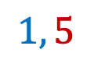
Nullclines (or isoclines) of the Lotka-Volterra competition model
$$\frac{dx_{1}}{dt}={r_{1}x}_{1}\left(1−\frac{x_{1}}{K_{1}}−\frac{x_{2}α_{12}}{K_{1}}\right)$$
Following a perturbation, the population should return to equilibrium!
For $x_{1}$, this will always mean moving along the x-axis to the nullcline, then along the nullcline to equilibrium.
You can also test it by solving $\frac{dx_{1}}{dt}\text{for} \text{different} \text{values}\text{!}$
$K_{1}=4 ;α_{12}=.5$
$$8$$
$$x_{2}$$
$$1, 5$$
$$0$$
$$x_{1}$$
$$4$$

Slide 35

Nullclines (or isoclines) of the Lotka-Volterra competition model
$$\frac{dx_{1}}{dt}={r_{1}x}_{1}\left(1−\frac{x_{1}}{K_{1}}−\frac{x_{2}α_{12}}{K_{1}}\right)$$
Following a perturbation, the population should return to equilibrium!
For $x_{1}$, this will always mean moving along the x-axis to the nullcline, then along the nullcline to equilibrium.
You can also test it by solving $\frac{dx_{1}}{dt}\text{for} \text{different} \text{values}\text{!}$
$K_{1}=4 ;α_{12}=.5$
$$\frac{dx_{1}}{dt}=r_{1}∗1\left(1−\frac{1}{4}−\frac{5∗.5}{4}\right)$$
$$8$$
$$x_{2}$$
$$1, 5$$
$$0$$
$$x_{1}$$
$$4$$

Slide 36

Nullclines (or isoclines) of the Lotka-Volterra competition model
$$\frac{dx_{1}}{dt}={r_{1}x}_{1}\left(1−\frac{x_{1}}{K_{1}}−\frac{x_{2}α_{12}}{K_{1}}\right)$$
Following a perturbation, the population should return to equilibrium!
For $x_{1}$, this will always mean moving along the x-axis to the nullcline, then along the nullcline to equilibrium.
You can also test it by solving $\frac{dx_{1}}{dt}\text{for} \text{different} \text{values}\text{!}$
$K_{1}=4 ;α_{12}=.5$
$$\frac{dx_{1}}{dt}=r_{1}∗1\left(1−\frac{1}{4}−\frac{5∗.5}{4}\right)$$
$$\frac{dx_{1}}{dt}=r_{1}∗1\left(1−.25−.56\right)$$
$$8$$
$$x_{2}$$
$$1, 5$$
$$0$$
$$x_{1}$$
$$4$$

Slide 37

Nullclines (or isoclines) of the Lotka-Volterra competition model
$$\frac{dx_{1}}{dt}={r_{1}x}_{1}\left(1−\frac{x_{1}}{K_{1}}−\frac{x_{2}α_{12}}{K_{1}}\right)$$
Following a perturbation, the population should return to equilibrium!
For $x_{1}$, this will always mean moving along the x-axis to the nullcline, then along the nullcline to equilibrium.
You can also test it by solving $\frac{dx_{1}}{dt}\text{for} \text{different} \text{values}\text{!}$
$K_{1}=4 ;α_{12}=.5$
$$\frac{dx_{1}}{dt}=r_{1}∗1\left(1−\frac{1}{4}−\frac{5∗.5}{4}\right)$$
$$\frac{dx_{1}}{dt}=\left(+\right)$$
$$8$$
$$x_{2}$$
$$1, 5$$
$$0$$
$$x_{1}$$
$$4$$

Slide 38
Nullclines (or isoclines) of the Lotka-Volterra competition model
These are the lines that correspond to conditions when the rate of change for one species is 0.
Nullclines for species 2 occur at all conditions for which $\frac{dx_{2}}{dt}=0$
$$x_{2}$$
$$0$$
$$x_{1}$$

Slide 39


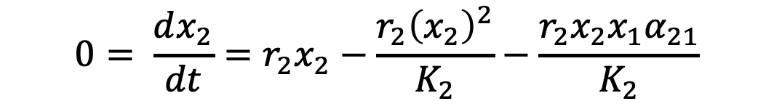
Nullclines (or isoclines) of the Lotka-Volterra competition model
These are the lines that correspond to conditions when the rate of change for one species is 0.
Nullclines for species 2 occur at all conditions for which $\frac{dx_{2}}{dt}=0$
$$0= \frac{dx_{2}}{dt}={r_{2}x}_{2}−\frac{r_{2}{\left(x_{2}\right)}^{2}}{K_{2}}−\frac{r_{2}x_{2}x_{1}α_{21}}{K_{2}}$$
$$0={r_{2}x}_{2}−\frac{r_{2}{\left(x_{2}\right)}^{2}}{K_{2}}−\frac{r_{2}x_{2}x_{1}α_{21}}{K_{2}}$$
$$0={r_{2}x}_{2}\left(1−\frac{x_{2}}{K_{2}}−\frac{x_{1}α_{21}}{K_{2}}\right)$$
$$x_{2}$$
$$0$$
$$x_{1}$$

Slide 40

Nullclines (or isoclines) of the Lotka-Volterra competition model
These are the lines that correspond to conditions when the rate of change for one species is 0.
Nullclines for species 2 occur at all conditions for which $\frac{dx_{2}}{dt}=0$
$$0= \frac{dx_{2}}{dt}={r_{2}x}_{2}−\frac{r_{2}{\left(x_{2}\right)}^{2}}{K_{2}}−\frac{r_{2}x_{2}x_{1}α_{21}}{K_{2}}$$
$$0={r_{2}x}_{2}−\frac{r_{2}{\left(x_{2}\right)}^{2}}{K_{2}}−\frac{r_{2}x_{2}x_{1}α_{21}}{K_{2}}$$
$$0={r_{2}x}_{2}\left(1−\frac{x_{2}}{K_{2}}−\frac{x_{1}α_{21}}{K_{2}}\right)$$
first nullcline at $x_{2}=0$
$$0$$
$$x_{1}$$

Slide 41
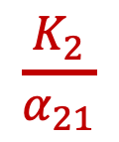



Nullclines (or isoclines) of the Lotka-Volterra competition model
These are the lines that correspond to conditions when the rate of change for one species is 0.
Nullclines for species 2 occur at all conditions for which $\frac{dx_{2}}{dt}=0$
$$0= \frac{dx_{2}}{dt}={r_{2}x}_{2}−\frac{r_{2}{\left(x_{2}\right)}^{2}}{K_{2}}−\frac{r_{2}x_{2}x_{1}α_{21}}{K_{2}}$$
$$0={r_{2}x}_{2}−\frac{r_{2}{\left(x_{2}\right)}^{2}}{K_{2}}−\frac{r_{2}x_{2}x_{1}α_{21}}{K_{2}}$$
$$0={r_{2}x}_{2}\left(1−\frac{x_{2}}{K_{2}}−\frac{x_{1}α_{21}}{K_{2}}\right)$$
$$x_{2}$$
$$K_{2}$$
first nullcline at $x_{2}=0$
second nullcline at $x_{2}=−α_{21}x_{1}+K_{2}$
$$0$$
$$x_{1}$$
$$\frac{K_{2}}{α_{21}}$$

Slide 42
Nullclines (or isoclines) of the Lotka-Volterra competition model
Following a perturbation, the population should return to equilibrium!
$$x_{2}$$
$$K_{2}$$
$$0$$
$$x_{1}$$
$$\frac{K_{2}}{α_{21}}$$

Slide 43

Nullclines (or isoclines) of the Lotka-Volterra competition model
Following a perturbation, the population should return to equilibrium!
For $x_{2}$, this will always mean moving along the y-axis to the nullcline, then along the nullcline to equilibrium.
$$x_{2}$$
$$K_{2}$$
$$0$$
$$x_{1}$$
$$\frac{K_{2}}{α_{21}}$$

Slide 44



Nullclines (or isoclines) of the Lotka-Volterra competition model
$${{\frac{dx_{2}}{dt}=r}_{2}x}_{2}\left(1−\frac{x_{2}}{K_{2}}−\frac{x_{1}α_{21}}{K_{2}}\right)$$
Following a perturbation, the population should return to equilibrium!
For $x_{2}$, this will always mean moving along the y-axis to the nullcline, then along the nullcline to equilibrium.
You can also test it by solving $\frac{dx_{2}}{dt}\text{for} \text{different} \text{values}\text{!}$
$$x_{2}$$
$$K_{2}$$
$$0$$
$$x_{1}$$
$$\frac{K_{2}}{α_{21}}$$

Slide 45




Nullclines (or isoclines) of the Lotka-Volterra competition model
$${{\frac{dx_{2}}{dt}=r}_{2}x}_{2}\left(1−\frac{x_{2}}{K_{2}}−\frac{x_{1}α_{21}}{K_{2}}\right)$$
Following a perturbation, the population should return to equilibrium!
For $x_{2}$, this will always mean moving along the y-axis to the nullcline, then along the nullcline to equilibrium.
You can also test it by solving $\frac{dx_{2}}{dt}\text{for} \text{different} \text{values}\text{!}$
$K_{2}=6 ;α_{21}=.3$
$$x_{2}$$
$$7, 8$$
$$6$$
$$0$$
$$x_{1}$$
$$20$$

Slide 46

Nullclines (or isoclines) of the Lotka-Volterra competition model
$${{\frac{dx_{2}}{dt}=r}_{2}x}_{2}\left(1−\frac{x_{2}}{K_{2}}−\frac{x_{1}α_{21}}{K_{2}}\right)$$
Following a perturbation, the population should return to equilibrium!
For $x_{2}$, this will always mean moving along the y-axis to the nullcline, then along the nullcline to equilibrium.
You can also test it by solving $\frac{dx_{2}}{dt}\text{for} \text{different} \text{values}\text{!}$
$K_{2}=6 ;α_{21}=.3$
$$x_{2}$$
$${\frac{dx_{2}}{dt}=r}_{2}∗8\left(1−\frac{8}{6}−\frac{7∗.3}{6}\right)$$
$$7, 8$$
$$6$$
$$0$$
$$x_{1}$$
$$20$$

Slide 47

Nullclines (or isoclines) of the Lotka-Volterra competition model
$${{\frac{dx_{2}}{dt}=r}_{2}x}_{2}\left(1−\frac{x_{2}}{K_{2}}−\frac{x_{1}α_{21}}{K_{2}}\right)$$
Following a perturbation, the population should return to equilibrium!
For $x_{2}$, this will always mean moving along the y-axis to the nullcline, then along the nullcline to equilibrium.
You can also test it by solving $\frac{dx_{2}}{dt}\text{for} \text{different} \text{values}\text{!}$
$K_{2}=6 ;α_{21}=.3$
$$x_{2}$$
$${\frac{dx_{2}}{dt}=r}_{2}∗8\left(1−\frac{8}{6}−\frac{7∗.3}{6}\right)$$
$${\frac{dx_{2}}{dt}=r}_{2}∗8\left(1−1.3−.35\right)$$
$$7, 8$$
$$6$$
$$0$$
$$x_{1}$$
$$20$$

Slide 48


Nullclines (or isoclines) of the Lotka-Volterra competition model
$${{\frac{dx_{2}}{dt}=r}_{2}x}_{2}\left(1−\frac{x_{2}}{K_{2}}−\frac{x_{1}α_{21}}{K_{2}}\right)$$
Following a perturbation, the population should return to equilibrium!
For $x_{2}$, this will always mean moving along the y-axis to the nullcline, then along the nullcline to equilibrium.
You can also test it by solving $\frac{dx_{2}}{dt}\text{for} \text{different} \text{values}\text{!}$
$K_{2}=6 ;α_{21}=.3$
$$x_{2}$$
$${\frac{dx_{2}}{dt}=r}_{2}∗8\left(1−\frac{8}{6}−\frac{7∗.3}{6}\right)$$
$$\frac{dx_{2}}{dt}=\left(−\right)$$
$$7, 8$$
$$6$$
$$0$$
$$x_{1}$$
$$20$$

Slide 49

Nullclines (or isoclines) of the Lotka-Volterra competition model
$${{\frac{dx_{2}}{dt}=r}_{2}x}_{2}\left(1−\frac{x_{2}}{K_{2}}−\frac{x_{1}α_{21}}{K_{2}}\right)$$
Following a perturbation, the population should return to equilibrium!
For $x_{2}$, this will always mean moving along the y-axis to the nullcline, then along the nullcline to equilibrium.
You can also test it by solving $\frac{dx_{2}}{dt}\text{for} \text{different} \text{values}\text{!}$
$K_{2}=6 ;α_{21}=.3$
$$x_{2}$$
$$6$$
$$4, 2$$
$$0$$
$$x_{1}$$
$$20$$

Slide 50

Nullclines (or isoclines) of the Lotka-Volterra competition model
$${{\frac{dx_{2}}{dt}=r}_{2}x}_{2}\left(1−\frac{x_{2}}{K_{2}}−\frac{x_{1}α_{21}}{K_{2}}\right)$$
Following a perturbation, the population should return to equilibrium!
For $x_{2}$, this will always mean moving along the y-axis to the nullcline, then along the nullcline to equilibrium.
You can also test it by solving $\frac{dx_{2}}{dt}\text{for} \text{different} \text{values}\text{!}$
$K_{2}=6 ;α_{21}=.3$
$$x_{2}$$
$${\frac{dx_{2}}{dt}=r}_{2}∗2\left(1−\frac{2}{6}−\frac{4∗.3}{6}\right)$$
$$6$$
$$4, 2$$
$$0$$
$$x_{1}$$
$$20$$

Slide 51

Nullclines (or isoclines) of the Lotka-Volterra competition model
$${{\frac{dx_{2}}{dt}=r}_{2}x}_{2}\left(1−\frac{x_{2}}{K_{2}}−\frac{x_{1}α_{21}}{K_{2}}\right)$$
Following a perturbation, the population should return to equilibrium!
For $x_{2}$, this will always mean moving along the y-axis to the nullcline, then along the nullcline to equilibrium.
You can also test it by solving $\frac{dx_{2}}{dt}\text{for} \text{different} \text{values}\text{!}$
$K_{2}=6 ;α_{21}=.3$
$$x_{2}$$
$${\frac{dx_{2}}{dt}=r}_{2}∗2\left(1−\frac{2}{6}−\frac{4∗.3}{6}\right)$$
$${\frac{dx_{2}}{dt}=r}_{2}∗2\left(1−.33−.2\right)$$
$$6$$
$$4, 2$$
$$0$$
$$x_{1}$$
$$20$$

Slide 52



Nullclines (or isoclines) of the Lotka-Volterra competition model
$${{\frac{dx_{2}}{dt}=r}_{2}x}_{2}\left(1−\frac{x_{2}}{K_{2}}−\frac{x_{1}α_{21}}{K_{2}}\right)$$
Following a perturbation, the population should return to equilibrium!
For $x_{2}$, this will always mean moving along the y-axis to the nullcline, then along the nullcline to equilibrium.
You can also test it by solving $\frac{dx_{2}}{dt}\text{for} \text{different} \text{values}\text{!}$
$K_{2}=6 ;α_{21}=.3$
$$x_{2}$$
$${\frac{dx_{2}}{dt}=r}_{2}∗2\left(1−\frac{2}{6}−\frac{4∗.3}{6}\right)$$
$$\frac{dx_{2}}{dt}=\left(+\right)$$
$$6$$
$$4, 2$$
$$0$$
$$x_{1}$$
$$20$$

Slide 53

Given different combinations of $x_{1}$and $x_{2}$ what is the outcome of competition?
$$\frac{K_{1}}{α_{12}}$$
$$x_{2}$$
$$K_{2}$$
$$0$$
$$x_{1}$$
$$K_{1}$$
$$\frac{K_{2}}{α_{21}}$$

Slide 54


Given different combinations of $x_{1}$and $x_{2}$ what is the outcome of competition?
System will converge to one of its equilibria, depending on the values of the competition and carrying capacity parameters.
We can solve $\frac{dx_{1}}{dt} \text{at} \text{different} \text{combinations} \text{of} x_{1}$and $x_{2}$ to test the direction the $x_{1}$population will move during competition (always along the x-axis).
We can solve $\frac{dx_{2}}{dt} \text{at} \text{different} \text{combinations} \text{of} x_{1}$and $x_{2}$ to test the direction the $x_{2}$population will move during competition (always along the y-axis).
$$x_{2}$$
$$\frac{K_{1}}{α_{12}}$$
$$K_{2}$$
$$0$$
$$x_{1}$$
$$K_{1}$$
$$\frac{K_{2}}{α_{21}}$$

Slide 55









Given different combinations of $x_{1}$and $x_{2}$ what is the outcome of competition?
$$\frac{K_{1}}{α_{12}}$$
$$x_{2}$$
$$x_{2}$$
$$K_{2}$$
$$0$$
$$x_{1}$$
$$0$$
$$x_{1}$$
$$K_{1}$$
$$\frac{K_{2}}{α_{21}}$$
We can use vector addition from the individual nullclines to determine the outcome of competition.

Slide 56
Given different combinations of $x_{1}$and $x_{2}$ what is the outcome of competition?
System will converge to one of its equilibria, depending on the values of the competition and carrying capacity parameters.
We can use vector addition in each quadrat from the individual nullclines to determine the outcome of competition.
$$x_{2}$$
$$\frac{K_{1}}{α_{12}}$$
$$K_{2}$$
$$0$$
$$x_{1}$$
$$K_{1}$$
$$\frac{K_{2}}{α_{21}}$$

Slide 57

Given different combinations of $x_{1}$and $x_{2}$ what is the outcome of competition?
System will converge to one of its equilibria, depending on the values of the competition and carrying capacity parameters.
We can use vector addition in each quadrat from the individual nullclines to determine the outcome of competition.
This configuration is a stable equilibrium, indicating stable coexistence at:
$$x_{2}$$
$$\frac{K_{1}}{α_{12}}$$
$$K_{2}$$
$$0$$
$$x_{1}$$
$$x_{1}^{∗}= \frac{K_{1}−K_{2}α_{12}}{1−α_{21}α_{12}} x_{2}^{∗}=\frac{K_{2}−K_{1}α_{21}}{1−α_{12}α_{21}}$$
$$K_{1}$$
$$\frac{K_{2}}{α_{21}}$$

Slide 58

Given different combinations of $x_{1}$and $x_{2}$ what is the outcome of competition?
Like before, we can also solve $\frac{dx_{1}}{dt} \text{at} \text{different} \text{combinations} \text{of} x_{1}$and $x_{2}$ to test the direction the $x_{1}$population will move during competition (always along the x-axis).
We can solve $\frac{dx_{2}}{dt} \text{at} \text{different} \text{combinations} \text{of} x_{1}$and $x_{2}$ to test the direction the $x_{2}$population will move during competition (always along the y-axis).
$$x_{2}$$
$$\frac{K_{1}}{α_{12}}$$
$$K_{2}$$
$$0$$
$$x_{1}$$
$$K_{1}$$
$$\frac{K_{2}}{α_{21}}$$

Slide 59
Given different combinations of $x_{1}$and $x_{2}$ what is the outcome of competition?
Like before, we can also solve $\frac{dx_{1}}{dt} \text{at} \text{different} \text{combinations} \text{of} x_{1}$and $x_{2}$ to test the direction the $x_{1}$population will move during competition (always along the x-axis).
We can solve $\frac{dx_{2}}{dt} \text{at} \text{different} \text{combinations} \text{of} x_{1}$and $x_{2}$ to test the direction the $x_{2}$population will move during competition (always along the y-axis).
$$x_{2}$$
$$\frac{K_{1}}{α_{12}}$$
$$K_{2}$$
$$0$$
$$x_{1}$$
$$K_{1}$$
$$\frac{K_{2}}{α_{21}}$$

Slide 60





Given different combinations of $x_{1}$and $x_{2}$ what is the outcome of competition?
Let’s try it!
$$K_{1}=2 ;α_{12}=.3$$
$$K_{2}=8 ;α_{21}=.8$$
$$x_{2}$$
$\frac{K_{1}}{α_{12}}$=10
$K_{2}$=8
$$0$$
$$x_{1}$$
$$\frac{K_{2}}{α_{21}}=10$$
$K_{1}$=2

Slide 61

Given different combinations of $x_{1}$and $x_{2}$ what is the outcome of competition?
Let’s try it!
$$K_{1}=2 ;α_{12}=.3$$
$$K_{2}=8 ;α_{21}=.8$$
$$x_{2}$$
$\frac{K_{1}}{α_{12}}$=10
$$\frac{dx_{1}}{dt}={r_{1}x}_{1}\left(1−\frac{x_{1}}{K_{1}}−\frac{x_{2}α_{12}}{K_{1}}\right)$$
$K_{2}$=8
3, 2
$$0$$
$$x_{1}$$
$$\frac{K_{2}}{α_{21}}=10$$
$K_{1}$=2

Slide 62

Given different combinations of $x_{1}$and $x_{2}$ what is the outcome of competition?
Let’s try it!
$$K_{1}=2 ;α_{12}=.3$$
$$K_{2}=8 ;α_{21}=.8$$
$$x_{2}$$
$\frac{K_{1}}{α_{12}}$=10
$$\frac{dx_{1}}{dt}={r_{1}x}_{1}\left(1−\frac{x_{1}}{K_{1}}−\frac{x_{2}α_{12}}{K_{1}}\right)$$
$K_{2}$=8
$$\frac{dx_{1}}{dt}=r_{1}∗3\left(1−\frac{3}{2}−\frac{2∗.3}{2}\right)$$
3, 2
$$0$$
$$x_{1}$$
$$\frac{K_{2}}{α_{21}}=10$$
$K_{1}$=2

Slide 63

Given different combinations of $x_{1}$and $x_{2}$ what is the outcome of competition?
Let’s try it!
$$K_{1}=2 ;α_{12}=.3$$
$$K_{2}=8 ;α_{21}=.8$$
$$x_{2}$$
$\frac{K_{1}}{α_{12}}$=10
$$\frac{dx_{1}}{dt}={r_{1}x}_{1}\left(1−\frac{x_{1}}{K_{1}}−\frac{x_{2}α_{12}}{K_{1}}\right)$$
$K_{2}$=8
$$\frac{dx_{1}}{dt}=r_{1}∗3\left(1−\frac{3}{2}−\frac{2∗.3}{2}\right)$$
3, 2
$$\frac{dx_{1}}{dt}=r_{1}∗3\left(1−1.5−0.3\right)$$
$$0$$
$$x_{1}$$
$$\frac{K_{2}}{α_{21}}=10$$
$K_{1}$=2

Slide 64




Given different combinations of $x_{1}$and $x_{2}$ what is the outcome of competition?
Let’s try it!
$$K_{1}=2 ;α_{12}=.3$$
$$K_{2}=8 ;α_{21}=.8$$
$$x_{2}$$
$\frac{K_{1}}{α_{12}}$=10
$$\frac{dx_{1}}{dt}={r_{1}x}_{1}\left(1−\frac{x_{1}}{K_{1}}−\frac{x_{2}α_{12}}{K_{1}}\right)$$
$$\frac{dx_{1}}{dt}=r_{1}∗3\left(1−\frac{3}{2}−\frac{2∗.3}{2}\right)$$
$K_{2}$=8
$$\frac{dx_{1}}{dt}=r_{1}∗3\left(1−1.5−0.3\right)$$
3, 2
$$0$$
$$x_{1}$$
$$\frac{K_{2}}{α_{21}}=10$$
$K_{1}$=2
$$\frac{dx_{1}}{dt}=\left(−\right)$$

Slide 65

Given different combinations of $x_{1}$and $x_{2}$ what is the outcome of competition?
Let’s try it!
$$K_{1}=2 ;α_{12}=.3$$
$$K_{2}=8 ;α_{21}=.8$$
$$x_{2}$$
$\frac{K_{1}}{α_{12}}$=10
$${{\frac{dx_{2}}{dt}=r}_{2}x}_{2}\left(1−\frac{x_{2}}{K_{2}}−\frac{x_{1}α_{21}}{K_{2}}\right)$$
$K_{2}$=8
3, 2
$$0$$
$$x_{1}$$
$$\frac{K_{2}}{α_{21}}=10$$
$K_{1}$=2

Slide 66

Given different combinations of $x_{1}$and $x_{2}$ what is the outcome of competition?
Let’s try it!
$$K_{1}=2 ;α_{12}=.3$$
$$K_{2}=8 ;α_{21}=.8$$
$$x_{2}$$
$\frac{K_{1}}{α_{12}}$=10
$${{\frac{dx_{2}}{dt}=r}_{2}x}_{2}\left(1−\frac{x_{2}}{K_{2}}−\frac{x_{1}α_{21}}{K_{2}}\right)$$
$K_{2}$=8
$${\frac{dx_{2}}{dt}=r}_{2}∗2\left(1−\frac{2}{8}−\frac{3∗.3}{8}\right)$$
3, 2
$$0$$
$$x_{1}$$
$$\frac{K_{2}}{α_{21}}=10$$
$K_{1}$=2

Slide 67

Given different combinations of $x_{1}$and $x_{2}$ what is the outcome of competition?
Let’s try it!
$$K_{1}=2 ;α_{12}=.3$$
$$K_{2}=8 ;α_{21}=.8$$
$$x_{2}$$
$\frac{K_{1}}{α_{12}}$=10
$${{\frac{dx_{2}}{dt}=r}_{2}x}_{2}\left(1−\frac{x_{2}}{K_{2}}−\frac{x_{1}α_{21}}{K_{2}}\right)$$
$K_{2}$=8
$${\frac{dx_{2}}{dt}=r}_{2}∗2\left(1−\frac{2}{8}−\frac{3∗.3}{8}\right)$$
3, 2
$${\frac{dx_{2}}{dt}=r}_{2}∗2\left(1−.25−.113\right)$$
$$0$$
$$x_{1}$$
$$\frac{K_{2}}{α_{21}}=10$$
$K_{1}$=2

Slide 68




Given different combinations of $x_{1}$and $x_{2}$ what is the outcome of competition?
Let’s try it!
$$K_{1}=2 ;α_{12}=.3$$
$$K_{2}=8 ;α_{21}=.8$$
$$x_{2}$$
$\frac{K_{1}}{α_{12}}$=10
$${{\frac{dx_{2}}{dt}=r}_{2}x}_{2}\left(1−\frac{x_{2}}{K_{2}}−\frac{x_{1}α_{21}}{K_{2}}\right)$$
$${\frac{dx_{2}}{dt}=r}_{2}∗2\left(1−\frac{2}{8}−\frac{3∗.3}{8}\right)$$
$K_{2}$=8
$${\frac{dx_{2}}{dt}=r}_{2}∗2\left(1−.25−.113\right)$$
3, 2
$$0$$
$$x_{1}$$
$$\frac{K_{2}}{α_{21}}=10$$
$K_{1}$=2
$$\frac{dx_{2}}{dt}=\left(+\right)$$

Slide 69

Given different combinations of $x_{1}$and $x_{2}$ what is the outcome of competition?
Let’s try it!
$$K_{1}=2 ;α_{12}=.3$$
$$K_{2}=8 ;α_{21}=.8$$
Results replicate graphical approach!
$$x_{2}$$
$\frac{K_{1}}{α_{12}}$=10
$K_{2}$=8
3, 2
$$0$$
$$x_{1}$$
$$\frac{K_{2}}{α_{21}}=10$$
$K_{1}$=2

Slide 70

Four possible outcomes for competition
Case 1:
Stable equilibrium, with coexistence at:
$$x_{2}$$
$$x_{1}^{∗}= \frac{K_{1}−K_{2}α_{12}}{1−α_{21}α_{12}} x_{2}^{∗}=\frac{K_{2}−K_{1}α_{21}}{1−α_{12}α_{21}}$$
$$\frac{K_{1}}{α_{12}}$$
$$K_{2}$$
$$0$$
$$x_{1}$$
$$K_{1}$$
$$\frac{K_{2}}{α_{21}}$$

Slide 71


Four possible outcomes for competition
Case 1:
Stable equilibrium, with coexistence at:
$$x_{2}$$
$$x_{1}^{∗}= \frac{K_{1}−K_{2}α_{12}}{1−α_{21}α_{12}} x_{2}^{∗}=\frac{K_{2}−K_{1}α_{21}}{1−α_{12}α_{21}}$$
$$\frac{K_{1}}{α_{12}}$$
$$\frac{K_{1}}{α_{12}}>K_{2} \&\frac{K_{2}}{α_{21}}>K_{1}$$
$$K_{2}$$
$${(α_{12}∗ α}_{21}<1)$$
$$0$$
$$x_{1}$$
$$K_{1}$$
$$\frac{K_{2}}{α_{21}}$$

Slide 72
Four possible outcomes for competition
Case 1:
Stable equilibrium, with coexistence at:
$$x_{2}$$
$$x_{1}^{∗}= \frac{K_{1}−K_{2}α_{12}}{1−α_{21}α_{12}} x_{2}^{∗}=\frac{K_{2}−K_{1}α_{21}}{1−α_{12}α_{21}}$$
$$\frac{K_{1}}{α_{12}}$$
$$\frac{K_{1}}{α_{12}}>K_{2} \&\frac{K_{2}}{α_{21}}>K_{1}$$
$$K_{2}$$
$${(α_{12}∗ α}_{21}<1)$$
Species coexist stably but below carrying capacity for each individual population.
Intraspecific competition is stronger than interspecific competition.
$$0$$
$$x_{1}$$
$$K_{1}$$
$$\frac{K_{2}}{α_{21}}$$

Slide 73



Case 1:
Stable equilibrium, with coexistence:
$$\frac{K_{1}}{α_{12}}>K_{2} \&\frac{K_{2}}{α_{21}}>K_{1}$$
$${(α_{12}∗ α}_{21}<1)$$

Slide 74








Four possible outcomes for competition
Case 2:
Species 1 outcompetes species 2
$$\frac{K_{1}}{α_{12}}$$
$$\frac{K_{1}}{α_{12}}>K_{2} \&\frac{K_{2}}{α_{21}}<K_{1}$$
$$K_{2}$$
$$x_{2}$$
$$0$$
$$x_{1}$$
$$K_{1}$$
$$\frac{K_{2}}{α_{21}}$$

Slide 75

Four possible outcomes for competition
Case 2:
Species 1 outcompetes species 2
$$\frac{K_{1}}{α_{12}}$$
$$\frac{K_{1}}{α_{12}}>K_{2} \&\frac{K_{2}}{α_{21}}<K_{1}$$
$$K_{2}$$
System collapses to equilibrium:
$$x_{1}^{∗}=K_{1}; x_{2}^{∗}=0$$
$$x_{2}$$
$$0$$
$$x_{1}$$
$$K_{1}$$
$$\frac{K_{2}}{α_{21}}$$

Slide 76


Case 2:
Species 1 outcompetes species 2
$$\frac{K_{1}}{α_{12}}>K_{2} \&\frac{K_{2}}{α_{21}}<K_{1}$$

Slide 77








Four possible outcomes for competition
Case 3:
Species 2 outcompetes species 1
$$\frac{K_{1}}{α_{12}}<K_{2} \&\frac{K_{2}}{α_{21}}>K_{1}$$
$$K_{2}$$
$$\frac{K_{1}}{α_{12}}$$
$$x_{2}$$
$$0$$
$$x_{1}$$
$$K_{1}$$
$$\frac{K_{2}}{α_{21}}$$

Slide 78

Four possible outcomes for competition
Case 3:
Species 2 outcompetes species 1
$$\frac{K_{1}}{α_{12}}<K_{2} \&\frac{K_{2}}{α_{21}}>K_{1}$$
$$K_{2}$$
$$\frac{K_{1}}{α_{12}}$$
System collapses to equilibrium:
$$x_{1}^{∗}=0; x_{2}^{∗}=K_{2}$$
$$x_{2}$$
$$0$$
$$x_{1}$$
$$K_{1}$$
$$\frac{K_{2}}{α_{21}}$$

Slide 79


Case 3:
Species 2 outcompetes species 1
$$\frac{K_{1}}{α_{12}}<K_{2} \&\frac{K_{2}}{α_{21}}>K_{1}$$

Slide 80




Four possible outcomes for competition
Case 4: Precedence
Aggressive interspecific competition.
Outcome depends on starting conditions.
$$K_{2}$$
$$\frac{K_{1}}{α_{12}}$$
$$K_{1}$$
$$\frac{K_{2}}{α_{21}}$$

Slide 81



Four possible outcomes for competition
Case 4: Precedence
Aggressive interspecific competition. Outcome depends on starting conditions.
$$\frac{K_{1}}{α_{12}}<K_{2} \&\frac{K_{2}}{α_{21}}<K_{1}$$
$$K_{2}$$
$${(α_{12}∗α}_{21}>1)$$
System will move towards either single species equilibria ($x_{1}^{∗}=0 ;x_{2}^{∗}=K_{2}$ OR $x_{1}^{∗}=K_{1};x_{2}^{∗}=0$), depending on starting conditions.
Under extremely unrealistic starting conditions, system will sit at an unstable equilibrium that will collapse in either direction following slight perturbation.
$$\frac{K_{1}}{α_{12}}$$
$$K_{1}$$
$$\frac{K_{2}}{α_{21}}$$

Slide 82

Case 4: Precedence
Aggressive interspecific competition.
Outcome depends on starting conditions.
Here, x1 outcompetes x2

Slide 83

Case 4: Precedence
Aggressive interspecific competition.
Outcome depends on starting conditions.
Here, x2 outcompetes x1

Slide 84

Case 4: Precedence
Aggressive interspecific competition.
Outcome depends on starting conditions.
Here, coexistence

Slide 85


Slide 86



Remember MSY, the semi-stable equilibrium:
$$\frac{dN}{dt}=rN\left(1−\frac{N}{K}\right) −H$$
K=5
r=0.25
H=.3125
$\frac{dN}{dt}=0.25∗1\left(1−\frac{1}{5}\right) −$.3125
$\frac{dN}{dt}=(−)$
N=1

Slide 87
Remember MSY, the semi-stable equilibrium:
$$\frac{dN}{dt}=rN\left(1−\frac{N}{K}\right) −H$$
K=5
r=0.25
H=.3125
$\frac{dN}{dt}=0.25∗1\left(1−\frac{1}{5}\right) −$.3125
$\frac{dN}{dt}=(−)$
N=1
In a semi-stable equilibrium, perturbations sometimes drive the system away from equilibrium.

Slide 88

Remember MSY, the semi-stable equilibrium:
$$\frac{dN}{dt}=rN\left(1−\frac{N}{K}\right) −H$$
K=5
r=0.25
H=.3125
$\frac{dN}{dt}=0.25∗4\left(1−\frac{4}{5}\right) −$.3125
$\frac{dN}{dt}=(−)$
N=4

Slide 89


Four possible outcomes for competition
Case 4: Precedence
Aggressive interspecific competition. Outcome depends on starting conditions.
In an unstable equilibrium, perturbations always drive the system away from equilibrium.
$$K_{2}$$
$$\frac{K_{1}}{α_{12}}<K_{2} \&\frac{K_{2}}{α_{21}}<K_{1}$$
$${(α_{12}∗α}_{21}>1)$$
$$\frac{K_{1}}{α_{12}}$$
$$K_{1}$$
$$\frac{K_{2}}{α_{21}}$$

Slide 90




Phase plane analysis: graphical determination of the behavior of the state variables in a dynamical system (here, populations of animals)
Case 1: Stable coexistence
Case 2: Spp. 1 wins
Case 3: Spp. 2 wins
Case 4: Precedence

Slide 91



Note the difference with a predator-prey model!
$$\frac{dx}{dt}=αx −βxy$$
Predator-prey cycles can be visualized as oscillations.
hare
(x)
$$\frac{dy}{dt}=δxy −γy$$
lynx
(y)
How does hare abundance vary with changes in lynx abundance?

Slide 92
Phase plane analysis: Why do we care?
We can use these tools to make predictions about the coexistence of species!

Slide 93

Principle of competitive exclusion
“Two species of approximately the same food habits are not likely to remain long evenly balanced in numbers in the same region. One will crowd out the other.”
- Joseph Grinnell, 1904:

Slide 94
Principle of competitive exclusion
“Two species of approximately the same food habits are not likely to remain long evenly balanced in numbers in the same region. One will crowd out the other.”
- Joseph Grinnell, 1904:
“Neither can live while the other survives.”
- J.K. Rowling, 2003

Slide 95




Principle of competitive exclusion
Paramecium aurelia
Paramecium caudatum
Paramecium bursaria
Oatmeal
Yeast
Gause 1934. J Experimental Biology.
Gause 1935. Science.
Notes:
Gause, Soviet biologist who experimentally demonstrated competitive exclusion in Lotka Volterra
In paramecium (eukaryotic, unicellular ciliates)

Slide 96
Gause first grew each species in isolation
Paramecium aurelia
Paramecium caudatum
Paramecium bursaria
Gause 1934. J Experimental Biology.
Gause 1935. Science.
Notes:
Gause, Soviet biologist who experimentally demonstrated competitive exclusion in Lotka Volterra
In paramecium (eukaryotic, unicellular ciliates)

Slide 97

In isolation, each species grew logistically.
Paramecium aurelia
Paramecium caudatum
Paramecium bursaria
Gause 1934. J Experimental Biology.
Gause 1935. Science.
Notes:
Gause, Soviet biologist who experimentally demonstrated competitive exclusion in Lotka Volterra
In paramecium (eukaryotic, unicellular ciliates)

Slide 98
Then, pairs of species were placed in the same beaker.
Paramecium aurelia
Paramecium caudatum
Paramecium caudatum
Paramecium bursaria
Gause 1934. J Experimental Biology.
Gause 1935. Science.
Notes:
Gause, Soviet biologist who experimentally demonstrated competitive exclusion in Lotka Volterra
In paramecium (eukaryotic, unicellular ciliates)

Slide 99

Competitive exclusion was observed:
Coexistence was observed:
Paramecium aurelia
Paramecium caudatum
Paramecium caudatum
Paramecium bursaria
Gause 1934. J Experimental Biology.
Gause 1935. Science.
Notes:
Gause, Soviet biologist who experimentally demonstrated competitive exclusion in Lotka Volterra
In paramecium (eukaryotic, unicellular ciliates)

Slide 100
Competitive exclusion was observed:
Coexistence was observed:
Paramecium aurelia
Paramecium caudatum
Paramecium caudatum
Paramecium bursaria
Species coexisted below each species’ respective individual carrying capacity.
Gause 1934. J Experimental Biology.
Gause 1935. Science.
Notes:
Gause, Soviet biologist who experimentally demonstrated competitive exclusion in Lotka Volterra
In paramecium (eukaryotic, unicellular ciliates)

Slide 101
Competitive exclusion was observed:
Coexistence was observed:
Paramecium aurelia
Paramecium caudatum
Paramecium caudatum
Paramecium bursaria
Species coexisted below each species’ respective individual carrying capacity.
The two coexisting species were largely partitioned in space. P. bursaria ate yeast at the bottom and P. caudatum consumed bacteria suspended in the medium.
Gause 1934. J Experimental Biology.
Gause 1935. Science.
Notes:
Gause, Soviet biologist who experimentally demonstrated competitive exclusion in Lotka Volterra
In paramecium (eukaryotic, unicellular ciliates)

Slide 102



Gause also demonstrated real-life predator-prey cycles with his experiments:
fish
(x)
Saccharomyces exiguus
shark
(y)
Paramecium aurelia
Gause 1935. Science.
Notes:
Gause, Soviet biologist who experimentally demonstrated competitive exclusion in Lotka Volterra
In paramecium (eukaryotic, unicellular ciliates)

Slide 103
Gause’s experiments:
Competitive exclusion was observed:
Coexistence was observed:
Paramecium aurelia
Paramecium caudatum
Paramecium caudatum
Paramecium bursaria
Species coexisted below each species’ respective individual carrying capacity.
The two coexisting species were largely partitioned in space. P. bursaria ate yeast at the bottom and P. caudatum consumed bacteria suspended in the medium.
Gause 1934. J Experimental Biology.
Gause 1935. Science.
Notes:
Gause, Soviet biologist who experimentally demonstrated competitive exclusion in Lotka Volterra
In paramecium (eukaryotic, unicellular ciliates)

Slide 104










Niche partitioning enables organisms to avoid competitive exclusion
Cape May Warbler
Myrtle Warbler
Niche: a match of a species to a specific environmental condition
$$x_{2}$$
$$x_{1}$$
$$x_{2}$$
$$x_{2}$$
$$x_{1}$$
MacArthur 1968. Ecology.
Notes:
5 species of warbler

Slide 105


Niche partitioning enables organisms to avoid competitive exclusion
Character displacement: similar species that live in the same geographical region and occupy similar niches differentiate in order to minimize niche overlap and avoid competitive exclusion.
Grant & Grant 2006. Science.

Slide 106
Niche partitioning enables organisms to avoid competitive exclusion
Character displacement: similar species that live in the same geographical region and occupy similar niches differentiate in order to minimize niche overlap and avoid competitive exclusion.
Species A
Species B
Use
Use
Competition
Resource
Grant & Grant 2006. Science.
When niches overlap, competition results

Slide 107
Niche partitioning enables organisms to avoid competitive exclusion
Character displacement: similar species that live in the same geographical region and occupy similar niches differentiate in order to minimize niche overlap and avoid competitive exclusion.
Species A
Species B
Use
Use
Resource
Grant & Grant 2006. Science.
Character displacement forces niches apart.

Slide 108


Niche partitioning enables organisms to avoid competitive exclusion
Often 10-25 large mammalian herbivores coexisting in the same African savanna!
Kartzinel et al. 2015. PNAS.

Slide 109

Niche partitioning enables organisms to avoid competitive exclusion
Dietary overlap is higher in similar-sized mammals
Kartzinel et al. 2015. PNAS.

Slide 110
Consumer resource partitioning in the African savanna
Grazer
(generalist)
Browser
(specialist)
Kartzinel et al. 2015. PNAS.

Slide 111


Slide 112
Community = interacting populations of different species
individual
population
fish
(x)
metapopulation
shark
(y)
community
How does fish abundance vary with changes in shark abundance?
ecosystem

Slide 113
Community = interacting populations of different species
individual
population
$$α_{12}$$
$$r_{1}$$
metapopulation
Fish A
(x₁)
Fish B
(x₂)
$$r_{2}$$
community
$$α_{21}$$
How does the abundance of fish species A vary with changes in the abundance of fish species B?
ecosystem

Slide 114





Community = interacting populations of different species
individual
population
$$births$$
Healthy
Fish
(susceptible)
$$trans−mission$$
Sick Fish (infected)
$$disease$$
$$death rate$$
metapopulation
$$natural$$
$$death rate$$
$$natural$$
$$death rate$$
community
How does the abundance of fish change based on infection with Mycobacterium marinum (wasting disease)?
ecosystem

Slide 115
Community = interacting populations of different species
$$births$$
Healthy
Fish
(susceptible)
$$trans−mission$$
Sick Fish (infected)
$$disease$$
$$death rate$$
$$natural$$
$$death rate$$
$$natural$$
$$death rate$$
How does the abundance of fish change based on infection with Mycobacterium marinum (wasting disease)?

Slide 116
Species can interact in several distinct ways.
Community = interacting populations of different species
$$births$$
Mutualism – both species benefit
Commensalism – one species benefits, the other is unaffected
Predation – one species benefits, the other is harmed (eaten!)
Competition – two species compete for the same limiting resource, both harmed by the interaction
Direct = wolves and coyote at a moose carcass
Indirect = diurnal cheetah, nocturnal leopard at a giraffe carcass
Parasitism – one species (the parasite) lives in or on the other species (the host)
Healthy
Fish
(susceptible)
$$trans−mission$$
Sick Fish (infected)
$$disease$$
$$death rate$$
$$natural$$
$$death rate$$
$$natural$$
$$death rate$$
How does the abundance of fish change based on infection with Mycobacterium marinum (wasting disease)?

Slide 117





Each box is a distinct population! When we model these populations, everyone in the box is considered the same. In a continuous time model (ODE), each box would get its own differential equation!
Population Biology
$$births$$
Healthy
Fish
(susceptible)
$$trans−mission$$
Sick Fish (infected)
$$disease$$
$$death rate$$
$$natural$$
$$death rate$$
$$natural$$
$$death rate$$
How does the abundance of fish change based on infection with Mycobacterium marinum (wasting disease)?

Slide 118
Each box is a distinct population! When we model these populations, everyone in the box is considered the same. In a continuous time model (ODE), each box would get its own differential equation!
Population Biology
$$births$$
Healthy
Fish
(susceptible)
$$trans−mission$$
Sick Fish (infected)
$$disease$$
$$death rate$$
$$natural$$
$$death rate$$
$$natural$$
$$death rate$$
How does the abundance of fish change based on infection with Mycobacterium marinum (wasting disease)?

Slide 119
Each box is a distinct population! When we model these populations, everyone in the box is considered the same. In a continuous time model (ODE), each box would get its own differential equation!
Population Biology
$$births$$
Healthy
Fish
(susceptible)
$$trans−mission$$
Sick Fish (infected)
$$disease$$
$$death rate$$
$$natural$$
$$death rate$$
$$natural$$
$$death rate$$
How does the abundance of fish change based on infection with Mycobacterium marinum (wasting disease)?

Slide 120
Each box is a distinct population! When we model these populations, everyone in the box is considered the same. In a continuous time model (ODE), each box would get its own differential equation!
Population Biology
$$births$$
Solid lines are processes by which individuals in each population move between boxes.
Dashed lines are influences of populations on rates (transmission is higher when there are more sick fish)
Healthy
Fish
(susceptible)
$$trans−mission$$
Sick Fish (infected)
$$disease$$
$$death rate$$
$$natural$$
$$death rate$$
$$natural$$
$$death rate$$
How does the abundance of fish change based on infection with Mycobacterium marinum (wasting disease)?

Slide 121


Each box is a distinct population! When we model these populations, everyone in the box is considered the same. In a continuous time model (ODE), each box would get its own differential equation!
Population Biology
$$births$$
Solid lines are processes by which individuals in each population move between boxes.
Dashed lines are influences of populations on rates (transmission is higher when there are more sick fish)
Healthy
Fish
(susceptible)
Sick Fish (infected)
$$disease$$
$$death rate$$
$$trans−mission$$
$$natural$$
$$death rate$$
$$natural$$
$$death rate$$
How does the abundance of fish change based on infection with Mycobacterium marinum (wasting disease)?

Slide 122





Population Biology
$$births$$
How does the abundance of fish change based on infection with Mycobacterium marinum (wasting disease)?
Healthy
Fish
(susceptible)
$$trans−mission$$
Sick Fish (infected)
$$disease$$
$$death rate$$
$$natural$$
$$death rate$$
$$natural$$
$$death rate$$
In disease ecology, we model populations based on their infection status.

Slide 123
Population Biology
$$births$$
How does the abundance of fish change based on infection with Mycobacterium marinum (wasting disease)?
Healthy
Fish
(susceptible)
$$trans−mission$$
Sick Fish (infected)
$$disease$$
$$death rate$$
$$natural$$
$$death rate$$
$$natural$$
$$death rate$$
Previously, we modeled populations of different species, or of distinct life history classes within a species.
In disease ecology, we model populations based on their infection status.

Slide 124



Parasites and Pathogens
Parasite: an organism that lives in or on another organism and benefits at the expense of others.
Ex: helminths (parasitic worms: tapeworms, roundworms, hookworms), ectoparasites (ticks, fleas)
Notes:
Parasite isPathogen

Slide 125
Parasites and Pathogens
Parasite: an organism that lives in or on another organism and benefits at the expense of others.
Ex: helminths (parasitic worms: tapeworms, roundworms, hookworms), ectoparasites (ticks, fleas)
Pathogen: a microorganism that can cause disease
Ex: bacterium, virus, protozoan
Notes:
Parasite isPathogen

Slide 126

Parasites and Pathogens
Parasite: an organism that lives in or on another organism and benefits at the expense of others.
Ex: helminths (parasitic worms: tapeworms, roundworms, hookworms), ectoparasites (ticks, fleas)
Pathogen: a microorganism that can cause disease
Ex: bacterium, virus, protozoan
Pathogen: Yersinia pestis
Disease: Plague
Notes:
Parasite isPathogen

Slide 127

Parasites and Pathogens
Parasite: an organism that lives in or on another organism and benefits at the expense of others.
Ex: helminths (parasitic worms: tapeworms, roundworms, hookworms), ectoparasites (ticks, fleas)
Pathogen: a microorganism that can cause disease
Ex: bacterium, virus, protozoan
Pathogen: Yersinia pestis
Disease: Plague
Pathogen: SARS-CoV-2
Disease: COVID-19
Notes:
Parasite isPathogen

Slide 128

Parasites and Pathogens
Parasite: an organism that lives in or on another organism and benefits at the expense of others.
Ex: helminths (parasitic worms: tapeworms, roundworms, hookworms), ectoparasites (ticks, fleas)
Pathogen: a microorganism that can cause disease
Ex: bacterium, virus, protozoan
Pathogen: Yersinia pestis
Disease: Plague
Pathogen: Plasmodium falciparum, P. vivax, P. malariae, P. ovale, P. knowlesi
Disease: malaria
Pathogen: SARS-CoV-2
Disease: COVID-19
Notes:
Parasite isPathogen

Slide 129


Parasites and Pathogens
Parasite: an organism that lives in or on another organism and benefits at the expense of others.
Ex: helminths (parasitic worms: tapeworms, roundworms, hookworms), ectoparasites (ticks, fleas)
Pathogen: a microorganism that can cause disease
Ex: bacterium, virus, protozoan
Host: the organism on/in which the parasite/pathogen lives
Ex: Soay sheep, grapes
Notes:
Parasite isPathogen

Slide 130

Parasites and Pathogens
Parasite: an organism that lives in or on another organism and benefits at the expense of others.
Ex: helminths (parasitic worms: tapeworms, roundworms, hookworms), ectoparasites (ticks, fleas)
Pathogen: a microorganism that can cause disease
Ex: bacterium, virus, protozoan
Host: the organism on/in which the parasite/pathogen lives
Ex: Soay sheep, grapes
Vector: an arthropod agent that carries and transmits a pathogen or parasite from host to host
Ex: mosquitoes, ticks, fleas
Notes:
Parasite isPathogen

Slide 131



We already know that parasites can play a role in regulating populations!
male juveniles with nematodes
male juveniles treated with antihelminthic
Soay Sheep of St. Kilda, Scotland
Gulland 1992. Parasitology.

Slide 132


Early work in red grouse experimentally demonstrated the power of parasites to regulate populations.
Hudson 1986. J Animal Ecology.
Hudson et al 1992. J Animal Ecology.
Hudson et al 1998. Science.

Slide 133


Slide 134




Early work in red grouse experimentally demonstrated the power of parasites to regulate populations.
Higher burden of the intestinal strongyle worm, Trichostrongylus tenuis, both reduces breeding success and increases mortality in red grouse.
Hudson 1986. J Animal Ecology.
Hudson et al 1992. J Animal Ecology.

Slide 135

Worms were hypothesized to be responsible for the observed population cycles in ‘bag data’ from northern England.
Hudson et al 1998. Science.

Slide 136
Deworming eliminated population cycles to prove this effect!
Hudson et al 1998. Science.

Slide 137
Parasites and pathogens have also shaped human history.
Notes:
Parasite isPathogen

Slide 138
Parasites and pathogens have also shaped human history.
But we have not always known they were responsible for disease!
Notes:
Parasite isPathogen

Slide 139
Parasites and pathogens have also shaped human history.
But we have not always known they were responsible for disease!
Four Humors: Hippocrates (c. 400 BC) wrote that disease results from an imbalance of the four humors
Notes:
Parasite isPathogen

Slide 140

Parasites and pathogens have also shaped human history.
But we have not always known they were responsible for disease!
Four Humors: Hippocrates (c. 400 BC) wrote that disease results from an imbalance of the four humors
Miasmatic Theory: Extension of Hippocrates that lasted through the 1800s – idea that disease was caused by bad air. Popularized by Florence Nightengale
Notes:
Parasite isPathogen

Slide 141

Parasites and pathogens have also shaped human history.
But we have not always known they were responsible for disease!
Four Humors: Hippocrates (c. 400 BC) wrote that disease results from an imbalance of the four humors
Miasmatic Theory: Extension of Hippocrates that lasted through the 1800s – idea that disease was caused by bad air.
Popularized by Florence Nightengale
Germ Theory of Disease: Idea that disease results from germs
Leuwenhoek’s microscope (1675)
Koch’s postulates (1890)
Notes:
Parasite isPathogen

Slide 142

Parasites and pathogens have also shaped human history.
But we have not always known they were responsible for disease!
Four Humors: Hippocrates (c. 400 BC) wrote that disease results from an imbalance of the four humors
Miasmatic Theory: Extension of Hippocrates that lasted through the 1800s – idea that disease was caused by bad air.
Popularized by Florence Nightengale
Germ Theory of Disease: Idea that disease results from germs
Leuwenhoek’s microscope (1675)
Koch’s postulates (1890)
Classic epidemiology
Risk factors for disease = John Snow (1854)
Notes:
Parasite isPathogen

Slide 143

Parasites and pathogens have also shaped human history.
Plague of Justinian (541-549 AD)
First historically recorded pandemic of Yersinia pestis
Launched the ‘first plague pandemic’ resulting in the deaths of 15-100 million people, 25-60% of Europe’s population at the time
Notes:
Parasite is an organism that lives in or on another organism and benefits at the expense of others.
Pathogen

Slide 144

Parasites and pathogens have also shaped human history.
Plague of Justinian (541-549 AD)
Black Death (1346-1353 AD)
Most fatal pandemic in human history, resulting in deaths of 75-200 million people
Killed 30-60% of Europe’s population at the time; 17-54% of global population
Notes:
By Flappiefh - Own work from:Natural Earth ;The origin and early spread of the Black Death in Italy: first evidence of plague victims from 14th-century Liguria (northern Italy) maps by O.J. Benedictow., CC BY-SA 4.0, https://commons.wikimedia.org/w/index.php?curid=66468361

Slide 145

Parasites and pathogens have also shaped human history.
Plague of Justinian (541-549 AD)
Black Death (1346-1353 AD)
Cocoliztli (1545-1548)
Pathogen still unknown! Maybe viral hemorrhagic fever, maybe bacterium
Killed 80% of the population of Mexico
Notes:
By Flappiefh - Own work from:Natural Earth ;The origin and early spread of the Black Death in Italy: first evidence of plague victims from 14th-century Liguria (northern Italy) maps by O.J. Benedictow., CC BY-SA 4.0, https://commons.wikimedia.org/w/index.php?curid=66468361

Slide 146

Parasites and pathogens have also shaped human history.
Plague of Justinian (541-549 AD)
Black Death (1346-1353 AD)
Cocoliztli (1545-1548)
Spanish Influenza (1918-1920)
17-100 million deaths worldwide.
1-5% of global population
2nd-most devastating pandemic in history (after Black Death)
Notes:
The pandemic broke out near the end of World War I, when wartime censors in the belligerent countries suppressed bad news to maintain morale, but newspapers freely reported the outbreak in neutral Spain, creating a false impression of Spain as the epicenter and leading to the "Spanish flu" misnomer.[

Slide 147


Parasites and pathogens have also shaped human history.
Plague of Justinian (541-549 AD)
Black Death (1346-1353 AD)
Cocoliztli (1545-1548)
Spanish Influenza (1918-1920)
HIV (~1960-now)
>40 million deaths and counting
Prevalence still >20% in some countries in southern Africa

Slide 148

Parasites and pathogens have also shaped human history.
Plague of Justinian (541-549 AD)
Black Death (1346-1353 AD)
Cocoliztli (1545-1548)
Spanish Influenza (1918-1920)
HIV (~1960-now)
COVID-19 (2019-now)
~7-29 million deaths worldwide
~0.1-0.4% of population
Notes:
According to a UNAIDS dataset sourced from the World Bank, in 2019 the HIV prevalence rate for adults aged 15 to 49 was 27% in Eswatini (Swaziland), 25% in Lesotho, 25% in Botswana and 19% in South Africa.^{[1]}

Slide 149
Parasites and pathogens have also shaped human DNA.
Notes:
The way in which sickle cell protects against malaria is attributed to several different things. One of the more common explanations is that the sickle hemoglobin inhibits the plasmodium parasite from infecting the red blood cells which reduces the number of malaria parasites to infect the host. Another factor is the production of heme oxygenase-1 (HO-1) enzyme, which is highly present in the sickle hemoglobin. This enzyme produces carbon monoxide which has been proven to protect against cerebral malaria
Normally, a person inherits two copies of the gene that produces beta-globin, a protein needed to produce normal hemoglobin (hemoglobin A, genotype AA). A person with sickle cell trait inherits one normal allele and one abnormal allele encoding hemoglobin S (hemoglobin genotype AS)
The sickle cell trait can be used to demonstrate the concepts of co-dominance and incomplete dominance. An individual with the sickle cell trait shows incomplete dominance when the shape of the red blood cell is considered. This is because the sickling happens only at low oxygen concentrations. With regards to the actual concentration of hemoglobin in the circulating cells, the alleles demonstrate co-dominance as both 'normal' and mutant forms co-exist in the bloodstream. Thus it is an ambiguous condition showing both incomplete dominance and co-dominance
2021, there were an estimated 247 million cases of malaria worldwide.
The estimated number of malaria deaths stood at 619 000 in 2021.
The WHO African Region carries a disproportionately high share of the global malaria burden. In 2021, the region was home to 95% of malaria cases and 96% of malaria deaths. Children under 5 accounted for about 80% of all malaria deaths in the Region.

Slide 150

Parasites and pathogens have also shaped human DNA.
Sickle cell anemia
The HbS allele confers resistance to malaria but also results in sickle cell anemia when homozygous.
Natural selection has favored this trait in malaria-endemic regions of the planet.
As of 2021, WHO estimates 247 million malaria cases worldwide and >600,000 deaths, 95% in Africa.
Children <5 account for 80% of malaria deaths.
Piel et al 2010. Nature Communications.
Notes:
The way in which sickle cell protects against malaria is attributed to several different things. One of the more common explanations is that the sickle hemoglobin inhibits the plasmodium parasite from infecting the red blood cells which reduces the number of malaria parasites to infect the host. Another factor is the production of heme oxygenase-1 (HO-1) enzyme, which is highly present in the sickle hemoglobin. This enzyme produces carbon monoxide which has been proven to protect against cerebral malaria
Normally, a person inherits two copies of the gene that produces beta-globin, a protein needed to produce normal hemoglobin (hemoglobin A, genotype AA). A person with sickle cell trait inherits one normal allele and one abnormal allele encoding hemoglobin S (hemoglobin genotype AS)
The sickle cell trait can be used to demonstrate the concepts of co-dominance and incomplete dominance. An individual with the sickle cell trait shows incomplete dominance when the shape of the red blood cell is considered. This is because the sickling happens only at low oxygen concentrations. With regards to the actual concentration of hemoglobin in the circulating cells, the alleles demonstrate co-dominance as both 'normal' and mutant forms co-exist in the bloodstream. Thus it is an ambiguous condition showing both incomplete dominance and co-dominance
2021, there were an estimated 247 million cases of malaria worldwide.
The estimated number of malaria deaths stood at 619 000 in 2021.
The WHO African Region carries a disproportionately high share of the global malaria burden. In 2021, the region was home to 95% of malaria cases and 96% of malaria deaths. Children under 5 accounted for about 80% of all malaria deaths in the Region.

Slide 151


Parasites and pathogens have also shaped human DNA.
Duffy antigen
Modeled distribution of Duffy-negative human population
Distribution Plasmodium falciparum
Distribution Plasmodium vivax
Guerra et al. 2006. Trends in Parasitology
Howes et al 2011. Nature Communications.

Slide 152
Epidemiology vs. Disease Ecology
Epidemiology = “the study of what is on the people”
Coined by Spanish physician Villalba in 1802
Emphasis on the study and analysis of the distribution and determinants of health and disease (“risk factors”)
Including chronic diseases!
Often uses cross-sectional data to demonstrate associations of variables with outcome (disease)
More statistical (y=mx+b)
Pattern
Disease Ecology = the study of how a disease spreads
Emphasis on the interactions of organisms with each other and the environment…when interactions result in disease
Emphasis on understanding the transmission dynamics of infectious disease
Typically involves fitting dynamical (population) models to time series data
More mathematical (dN/dt)
Process

Slide 153
Epidemiology vs. Disease Ecology
Epidemiology = “the study of what is on the people”
Coined by Spanish physician Villalba in 1802
Emphasis on the study and analysis of the distribution and determinants of health and disease (“risk factors”)
Including chronic diseases!
Often uses cross-sectional data to demonstrate associations of variables with outcome (disease)
More statistical (y=mx+b)
Pattern
Disease Ecology = the study of how a disease spreads
Emphasis on the interactions of organisms with each other and the environment…when interactions result in disease
Emphasis on understanding the transmission dynamics of infectious disease
Typically involves fitting dynamical (population) models to time series data
More mathematical (dN/dt)
Process

Slide 154
Epidemiology vs. Disease Ecology
Epidemiology = “the study of what is on the people”
Coined by Spanish physician Villalba in 1802
Emphasis on the study and analysis of the distribution and determinants of health and disease (“risk factors”)
Including chronic diseases!
Often uses cross-sectional data to demonstrate associations of variables with outcome (disease)
More statistical (y=mx+b)
Pattern
Disease Ecology = the study of how a disease spreads
Emphasis on the interactions of organisms with each other and the environment…when interactions result in disease
Emphasis on understanding the transmission dynamics of infectious disease
Typically involves fitting dynamical (population) models to time series data
More mathematical (dN/dt)
Process

Slide 155
Epidemiology vs. Disease Ecology
Epidemiology = “the study of what is on the people”
Coined by Spanish physician Villalba in 1802
Emphasis on the study and analysis of the distribution and determinants of health and disease (“risk factors”)
Including chronic diseases!
Often uses cross-sectional data to demonstrate associations of variables with outcome (disease)
More statistical (y=mx+b)
Pattern
Disease Ecology = the study of how a disease spreads
Emphasis on the interactions of organisms with each other and the environment…when interactions result in disease
Emphasis on understanding the transmission dynamics of infectious disease
Typically involves fitting dynamical (population) models to time series data
More mathematical (dN/dt)
Process

Slide 156
Epidemiology vs. Disease Ecology
Epidemiology = “the study of what is on the people”
Coined by Spanish physician Villalba in 1802
Emphasis on the study and analysis of the distribution and determinants of health and disease (“risk factors”)
Including chronic diseases!
Often uses cross-sectional data to demonstrate associations of variables with outcome (disease)
More statistical (y=mx+b)
Pattern
Disease Ecology = the study of how a disease spreads
Emphasis on the interactions of organisms with each other and the environment…when interactions result in disease
Emphasis on understanding the transmission dynamics of infectious disease
Typically involves fitting dynamical (population) models to time series data
More mathematical (dN/dt)
Process

Slide 157
The SIR Model
β
γ
S
Susceptible
I
Infectious
R
Recovered
β = transmission rate
γ = recovery rate
Kermack and McKendrick 1927 Proc Roy Soc A
Notes:
We based our epidemic framework is based on the suscetible-infectious-recovered SIR model developed by K and M in 1927

Slide 158





We class hosts into categories of susceptible, infectious, and recovered to model pathogen dynamics.
“antibody positive”
“seropositive”
β
γ
S
Susceptible
I
Infectious
R
Recovered
β = transmission rate
γ = recovery rate
Kermack and McKendrick 1927 Proc Roy Soc A
Notes:
We based our epidemic framework is based on the suscetible-infectious-recovered SIR model developed by K and M in 1927

Slide 159



We use computers to simulate systems of equations in the SIR framework.
$$\frac{dS}{dt}=−βSI$$
β
γ
S
Susceptible
I
Infectious
R
Recovered
$$\frac{dI}{dt}=βSI−γI$$
$$\frac{dR}{dt}=γI$$
β = transmission rate
γ = recovery rate
Kermack and McKendrick 1927 Proc Roy Soc A
Notes:
We based our epidemic framework is based on the suscetible-infectious-recovered SIR model developed by K and M in 1927

Slide 160


$$R_{o}$$
We use computers to simulate systems of equations in the SIR framework.
is the pathogen basic reproduction number.
$$\frac{dS}{dt}=−βSI$$
$$R_{0}=\frac{β}{γ}$$
β
γ
S
Susceptible
I
Infectious
R
Recovered
$$\frac{dI}{dt}=βSI−γI$$
$$\frac{dR}{dt}=γI$$
β = transmission rate
γ = recovery rate
Notes:
We based our epidemic framework is based on the suscetible-infectious-recovered SIR model developed by K and M in 1927

Slide 161

$$R_{o}$$
We use computers to simulate systems of equations in the SIR framework.
is the pathogen basic reproduction number.
$$\frac{dS}{dt}=−βSI$$
infections created
β
γ
$$R_{0}=\frac{β}{γ}$$
S
Susceptible
I
Infectious
R
Recovered
infections lost
$$\frac{dI}{dt}=βSI−γI$$
R₀ must be >1 for a disease to start spreading!
$$\frac{dR}{dt}=γI$$
β = transmission rate
γ = recovery rate
Notes:
We based our epidemic framework is based on the suscetible-infectious-recovered SIR model developed by K and M in 1927

Slide 162

$$R_{o}$$
The basic reproduction number for a pathogen

Slide 163
$$R_{o}$$
The basic reproduction number for a pathogen
Defined as: the number of new cases caused by one infectious case in a completely susceptible population

Slide 164
$$R_{o}$$
The basic reproduction number for a pathogen
Defined as: the number of new cases caused by one infectious case in a completely susceptible population

Slide 165
$$R_{o}$$
The basic reproduction number for a pathogen
Defined as: the number of new cases caused by one infectious case in a completely susceptible population

Slide 166
$$R_{o}$$
The basic reproduction number for a pathogen
Defined as: the number of new cases caused by one infectious case in a completely susceptible population

Slide 167
$$R_{o}$$
The basic reproduction number for a pathogen
Defined as: the number of new cases caused by one infectious case in a completely susceptible population

Slide 168
$$R_{o}$$
The basic reproduction number for a pathogen
Defined as: the number of new cases caused by one infectious case in a completely susceptible population

Slide 169

$$R_{o}$$
The basic reproduction number for a pathogen
Defined as: the number of new cases caused by one infectious case in a completely susceptible population
What is $R_{o}$?

Slide 170

$$R_{o}$$
The basic reproduction number for a pathogen
Defined as: the number of new cases caused by one infectious case in a completely susceptible population
What is $R_{o}$?
$R_{o}$ = 5

Slide 171



We can add realism to our models with births and deaths to maintain endemic pathogens.
μ
μ
μ
$$\frac{dS}{dt}=b(S+I+R)−βSI−μS$$
b
β
γ
S
Susceptible
I
Infectious
R
Recovered
$$\frac{dI}{dt}=βSI−γI−μI$$
$$\frac{dR}{dt}=γI−μR$$
b = birth rate
μ = death rate
β = transmission rate
γ = recovery rate
Notes:
We based our epidemic framework is based on the suscetible-infectious-recovered SIR model developed by K and M in 1927

Slide 172
We can estimate epidemic trajectories by fitting SIR models to infectious case count data.
μ
μ
μ
b
β
γ
S
Susceptible
I
Infectious
R
Recovered
Anderson & May 1991. Infectious Diseases of Humans
Notes:
Often, our data take the form of infectious case counts reporting to hospitals over time.
By adjusting our transmission rate such that our model projection of the number of infectious individuals best reproduces that witnessed in our data, we can project future epidemic trajectories

Slide 173

We can estimate epidemic trajectories by fitting SIR models to infectious case count data.
μ
μ
μ
b
β
γ
S
Susceptible
I
Infectious
R
Recovered
$$R_{0}=\frac{β}{γ+ μ}$$
b = birth rate
μ = death rate
β = transmission rate
γ = recovery rate
Anderson & May 1991. Infectious Diseases of Humans
Notes:
Often, our data take the form of infectious case counts reporting to hospitals over time.
By adjusting our transmission rate such that our model projection of the number of infectious individuals best reproduces that witnessed in our data, we can project future epidemic trajectories

Slide 174


We can estimate epidemic trajectories by fitting SIR models to infectious case count data.
μ
μ
μ
b
β
γ
S
Susceptible
I
Infectious
R
Recovered
$$R_{0}=\frac{β}{γ+ μ}$$
b = birth rate
μ = death rate
β = transmission rate
γ = recovery rate
$$R_{E}=R_{0}\frac{S}{N}$$
$≈λ$ for a population model
(epidemics spread @R_{E}>1 and decline @R_{E}<1)
Anderson & May 1991. Infectious Diseases of Humans
Notes:
Often, our data take the form of infectious case counts reporting to hospitals over time.
By adjusting our transmission rate such that our model projection of the number of infectious individuals best reproduces that witnessed in our data, we can project future epidemic trajectories

Slide 175




$$R_{E}$$
$$R_{t}$$
COVID projections for Illinois through March 2022
OR
The effective reproduction number for a pathogen
Defined as: the number of new cases caused by one infectious case in a partially susceptible population
Calculated as R0*proportion susceptible
$$R_{E}=R_{0}\frac{S}{N}$$
Gives a realistic pulse of the current pace of the epidemic!
epiforecasts.io

Slide 176
$$R_{E}$$
$$R_{t}$$
COVID projections for Illinois through March 2022
OR
The effective reproduction number for a pathogen
Defined as: the number of new cases caused by one infectious case in a partially susceptible population
Calculated as R0*proportion susceptible
$$R_{E}=R_{0}\frac{S}{N}$$
Gives a realistic pulse of the current pace of the epidemic!
epiforecasts.io

Slide 177
$$R_{E}$$
$$R_{t}$$
COVID projections for Illinois through March 2022
OR
The effective reproduction number for a pathogen
Defined as: the number of new cases caused by one infectious case in a partially susceptible population
Calculated as R0*proportion susceptible
$$R_{E}=R_{0}\frac{S}{N}$$
Gives a realistic pulse of the current pace of the epidemic!
epiforecasts.io

Slide 178
$$R_{E}$$
$$R_{t}$$
COVID projections for Illinois through March 2022
OR
The effective reproduction number for a pathogen
Defined as: the number of new cases caused by one infectious case in a partially susceptible population
Calculated as R0*proportion susceptible
$$R_{E}=R_{0}\frac{S}{N}$$
Gives a realistic pulse of the current pace of the epidemic!
epiforecasts.io

Slide 179

No matter the dynamics, not everyone gets infected before the epidemic ends!
$$\frac{dS}{dt}=−βSI$$
β
γ
S
Susceptible
I
Infectious
R
Recovered
$$\frac{dI}{dt}=βSI−γI$$
Not 1!
$$\frac{dR}{dt}=γR$$
β = transmission rate
γ = recovery rate
Not 0!
Notes:
We based our epidemic framework is based on the suscetible-infectious-recovered SIR model developed by K and M in 1927

Slide 180
No matter the dynamics, not everyone gets infected before the epidemic ends!
$$\frac{dS}{dt}=−βSI$$
β
γ
The epidemic does not end because all individuals have been infected and have either died or recovered.
Rather, finding new susceptibles becomes more difficult and R_{E} <1
S
Susceptible
I
Infectious
R
Recovered
$$\frac{dI}{dt}=βSI−γI$$
$$\frac{dR}{dt}=γI$$
β = transmission rate
γ = recovery rate
Notes:
We based our epidemic framework is based on the suscetible-infectious-recovered SIR model developed by K and M in 1927

Slide 181




Public health interventions can be employed to reduce both R₀ and R_{E}
$R_{0}$ interventions
$R_{E}$ interventions
Social distancing
Masking
Limits to gathering sizes
Drugs that shorten the infectious period
Vaccination

Slide 182
Public health interventions can be employed to reduce both R₀ and R_{E}
$R_{0}$ interventions
$R_{E}$ interventions
Social distancing
Masking
Limits to gathering sizes
Drugs that shorten the infectious period
Vaccination

Slide 183

Mathematics of Vaccination
Goal: Reduce $R_{E}<1$by removing individuals from the susceptible population.

Slide 184
Mathematics of Vaccination
Goal: Reduce $R_{E}<1$by removing individuals from the susceptible population.
β
γ
S
Susceptible
I
Infectious
R
Recovered
“antibody positive”
“seropositive”
β = transmission rate
γ = recovery rate

Slide 185


Mathematics of Vaccination
Goal: Reduce $R_{E}<1$by removing individuals from the susceptible population.
$$ν$$
β
γ
S
Susceptible
I
Infectious
R
Removed
“antibody positive”
“seropositive”
β = transmission rate
γ = recovery rate
$ν$ = vaccination rate

Slide 186

Mathematics of Vaccination
Goal: Reduce $R_{E}<1$by removing individuals from the susceptible population.
Because infectious periods tend to be short-lived (depending on the pathogen!), we can theoretically divide the population into two classes: S (susceptible) and V (vaccinated, or immune)
S
Susceptible
exposure
V
Vaccinated or Immune
or
vaccination

Slide 187

Mathematics of Vaccination
Goal: Reduce $R_{E}<1$by removing individuals from the susceptible population.
Because infectious periods tend to be short-lived (depending on the pathogen!), we can theoretically divide the population into two classes: S (susceptible) and V (vaccinated, or immune)
If $S+V=N$, then Prop. Susceptible + Prop. Vaccinated = 1.
S
Susceptible
exposure
V
Vaccinated or Immune
or
vaccination

Slide 188

Mathematics of Vaccination
Goal: Reduce $R_{E}<1$by removing individuals from the susceptible population.
Because infectious periods tend to be short-lived (depending on the pathogen!), we can theoretically divide the population into two classes: S (susceptible) and V (vaccinated, or immune)
If $S+V=N$, then Prop. Susceptible + Prop. Vaccinated = 1.
Remember, $R_{E}={R_{0}P}_{S}$ or $R_{E}=R_{0}\left({1−P}_{V}\right)$
S
Susceptible
exposure
V
Vaccinated or Immune
or
vaccination

Slide 189

Mathematics of Vaccination
Goal: Reduce $R_{E}<1$by removing individuals from the susceptible population.
Because infectious periods tend to be short-lived (depending on the pathogen!), we can theoretically divide the population into two classes: S (susceptible) and V (vaccinated, or immune)
If $S+V=N$, then Prop. Susceptible + Prop. Vaccinated = 1.
Remember, $R_{E}={R_{0}P}_{S}$ or $R_{E}=R_{0}\left({1−P}_{V}\right)$
$R_{E}<1≈ \left({1−P}_{V}\right)R_{0}<1$
S
Susceptible
exposure
V
Vaccinated or Immune
or
vaccination

Slide 190

Mathematics of Vaccination
Goal: Reduce $R_{E}<1$by removing individuals from the susceptible population.
Because infectious periods tend to be short-lived (depending on the pathogen!), we can theoretically divide the population into two classes: S (susceptible) and V (vaccinated, or immune)
If $S+V=N$, then Prop. Susceptible + Prop. Vaccinated = 1.
Remember, $R_{E}={R_{0}P}_{S}$ or $R_{E}=R_{0}\left({1−P}_{V}\right)$
$R_{E}<1≈ \left({1−P}_{V}\right)R_{0}<1$
Rearranging, $P_{V}$ $>1−\frac{1}{R_{0}}$
S
Susceptible
exposure
V
Vaccinated or Immune
or
vaccination

Slide 191

Mathematics of Vaccination
Goal: Reduce $R_{E}<1$by removing individuals from the susceptible population.
Because infectious periods tend to be short-lived (depending on the pathogen!), we can theoretically divide the population into two classes: S (susceptible) and V (vaccinated, or immune)
If $S+V=N$, then Prop. Susceptible + Prop. Vaccinated = 1.
Remember, $R_{E}={R_{0}P}_{S}$ or $R_{E}=R_{0}\left({1−P}_{V}\right)$
$R_{E}<1≈ \left({1−P}_{V}\right)R_{0}<1$
Rearranging, $P_{V}$ $>1−\frac{1}{R_{0}}$
This is the herd immunity threshold.
S
Susceptible
exposure
V
Vaccinated or Immune
or
vaccination

Slide 192

Mathematics of Vaccination
Goal: Reduce $R_{E}<1$by removing individuals from the susceptible population.
Because infectious periods tend to be short-lived (depending on the pathogen!), we can theoretically divide the population into two classes: S (susceptible) and V (vaccinated, or immune)
If $S+V=N$, then Prop. Susceptible + Prop. Vaccinated = 1.
Remember, $R_{E}={R_{0}P}_{S}$ or $R_{E}=R_{0}\left({1−P}_{V}\right)$
$R_{E}<1≈ \left({1−P}_{V}\right)R_{0}<1$
Rearranging, $P_{V}$ $>1−\frac{1}{R_{0}}$
This is the herd immunity threshold.
Even susceptibles will not become infected because the disease will not spread ($R_{E}<1$).
S
Susceptible
exposure
V
Vaccinated or Immune
or
vaccination

Slide 193
Extra

Slide 194
Population Biology
Conservation Biology
Disease Ecology
Goal:
protect populations from extinction
Concept:
Minimum Viable Population size (MVP)
Approach:
protected area reserves
Goal:
protect populations from disease via pathogen extinction
Concept:
Critical Community Size (CCS)
Approach:
sanitation
vaccination

Slide 195
Population Biology
Conservation Biology
Disease Ecology
Goal:
protect populations from extinction
Concept:
Minimum Viable Population size (MVP)
Approach:
protected area reserves
Goal:
protect populations from disease via pathogen extinction
Concept:
Critical Community Size (CCS)
Approach:
sanitation
vaccination

Slide 196
Population Biology
Conservation Biology
Disease Ecology
Goal:
protect populations from extinction
Concept:
Minimum Viable Population size (MVP)
Approach:
protected area reserves
Goal:
protect populations from disease via pathogen extinction
Concept:
Critical Community Size (CCS)
Approach:
sanitation
vaccination

Slide 197
Population Biology
Conservation Biology
Disease Ecology
Goal:
protect populations from extinction
Concept:
Minimum Viable Population size (MVP)
Approach:
protected area reserves
Goal:
protect populations from disease via pathogen extinction
Concept:
Critical Community Size (CCS)
Approach:
sanitation
vaccination

Slide 198
Population Biology
Conservation Biology
Disease Ecology
Goal:
protect populations from extinction
Concept:
Minimum Viable Population size (MVP)
Approach:
protected area reserves
Goal:
protect populations from disease via pathogen extinction
Concept:
Critical Community Size (CCS)
Approach:
sanitation
vaccination

Slide 199
Population Biology
Conservation Biology
Disease Ecology
Goal:
protect populations from extinction
Concept:
Minimum Viable Population size (MVP)
Approach:
protected area reserves
Goal:
protect populations from disease via pathogen extinction
Concept:
Critical Community Size (CCS)
Approach:
sanitation
vaccination

Slide 200
Population Biology
Conservation Biology
Disease Ecology
Goal:
protect populations from extinction
Concept:
Minimum Viable Population size (MVP)
Approach:
protected area reserves
Goal:
protect populations from disease via pathogen extinction
Concept:
Critical Community Size (CCS)
Approach:
sanitation
vaccination

Slide 201


December 16, 2022 E2M2.org
E²M²: Ecological and Epidemiological Modeling in Madagascar
Notes:
I unite these every year in a simple programming and modeling course (E2M2) which I teach for students in Madagascar

Slide 202

Sometimes stochasticity and space are all you need to ensure coexistence in a competitive environment
Kerr et al. modeled a community of 3 strains of E. coli with overlapping resource requirements (C,R, and S), occupying distinct spatial patches in a metapopulation.
They produced simulations allowing for a perfectly mixed population (global neighborhood), or a population in which dispersal (mixing) happened only locally. allowed to disperse only locally.
Local interactions allowed for the coexistence of all three strains (in theory). Experimentally?
Kerr et al. 2002. Nature.
Notes:
(remember metapopulations!

Slide 203
Sometimes stochasticity and space are all you need to ensure coexistence in a competitive environment
Kerr et al. modeled a community of 3 strains of E. coli with overlapping resource requirements (C,R, and S), occupying distinct spatial patches in a metapopulation.
They produced simulations allowing for a perfectly mixed population (global neighborhood), or a population in which dispersal (mixing) happened only locally.
Local interactions allowed for the coexistence of all three strains (in theory). Experimentally?
Kerr et al. 2002. Nature.
Notes:
(remember metapopulations!

Slide 204
Sometimes stochasticity and space are all you need to ensure coexistence in a competitive environment
The authors modeled a community of 3 strains of E. coli with overlapping resource requirements (C,R, and S), occupying distinct spatial patches in a metapopulation.
They produced simulations allowing for a perfectly mixed population (global neighborhood), or a population in which dispersal (mixing) happened only locally.
Local interactions allowed for the coexistence of all three strains (in theory). What about experimentally?
Kerr et al. 2002. Nature.
Notes:
(remember metapopulations!

Slide 205


Sometimes adding stochasticity and space (remember metapopulations!) is all you need to ensure coexistence!
Kerr et al. 2002. Nature.

